Slide 1

BEACON of HEALTH
Why & How to Change the Way We Think About Living

Slide 2

You’re Born an Original, Don’t Die a Copy. - John Mason

Slide 3


Slide 4


WHERE THERE IS PLANNING….
THERE IS POSSIBILITY

Slide 5

2022 West Virginia DHHR Survey
20%+ had trouble walking & climbing stairs.
74.4% were overweight or obese (higher in men)
More than ⅓ do not get adequate sleep
30% of us do not exercise or participate in an active leisure activity
More than 40% have arthritis
Tobacco use, cancer, heart disease & diabetes are on the rise

Slide 6
Lesson Plan for Longevity
Objectives: Live a long, fruitful life.
Not be a burden to my family, be a benefit.
Goals: Dance at grandchildren’s wedding
Walk up and down stairs with ease
Be independent from lifelong medications

Slide 7


HABIT CYCLE - Charles Duhigg
QUEUE
REWARD
ROUTINE

Slide 8

Skipping meals speeds up weight loss
All Calories are created equal
Fat Makes You Fat
Gluten is bad
Low Fat = Healthier Choice
Lifting Weights will bulk you up
FAKE NEWS!

Slide 9


Slide 10


The Average American consumes 17 teaspoons of sugar a day.
Fatty liver
Weight Gain
Insulin Resistance
Inflammation
Heart Disease
Diabetes
Dysbiosis
Brain Function
AGE’s
Addictive

Slide 11
There's 262 names for sugar in food! WHAT ARE THEY? - lilsipper
262 Names for Sugar

Slide 12
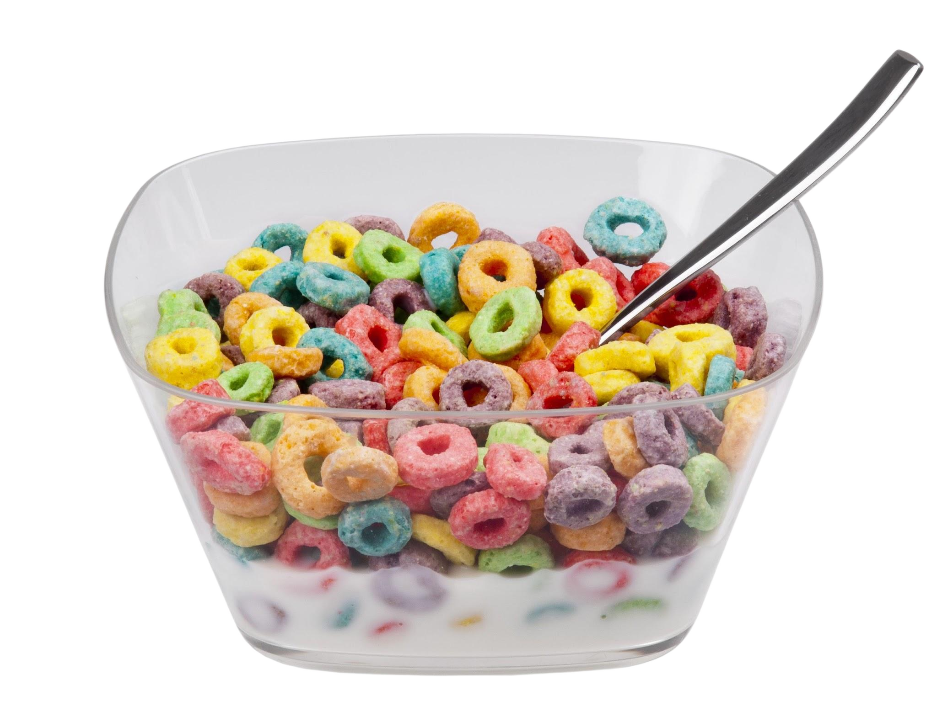

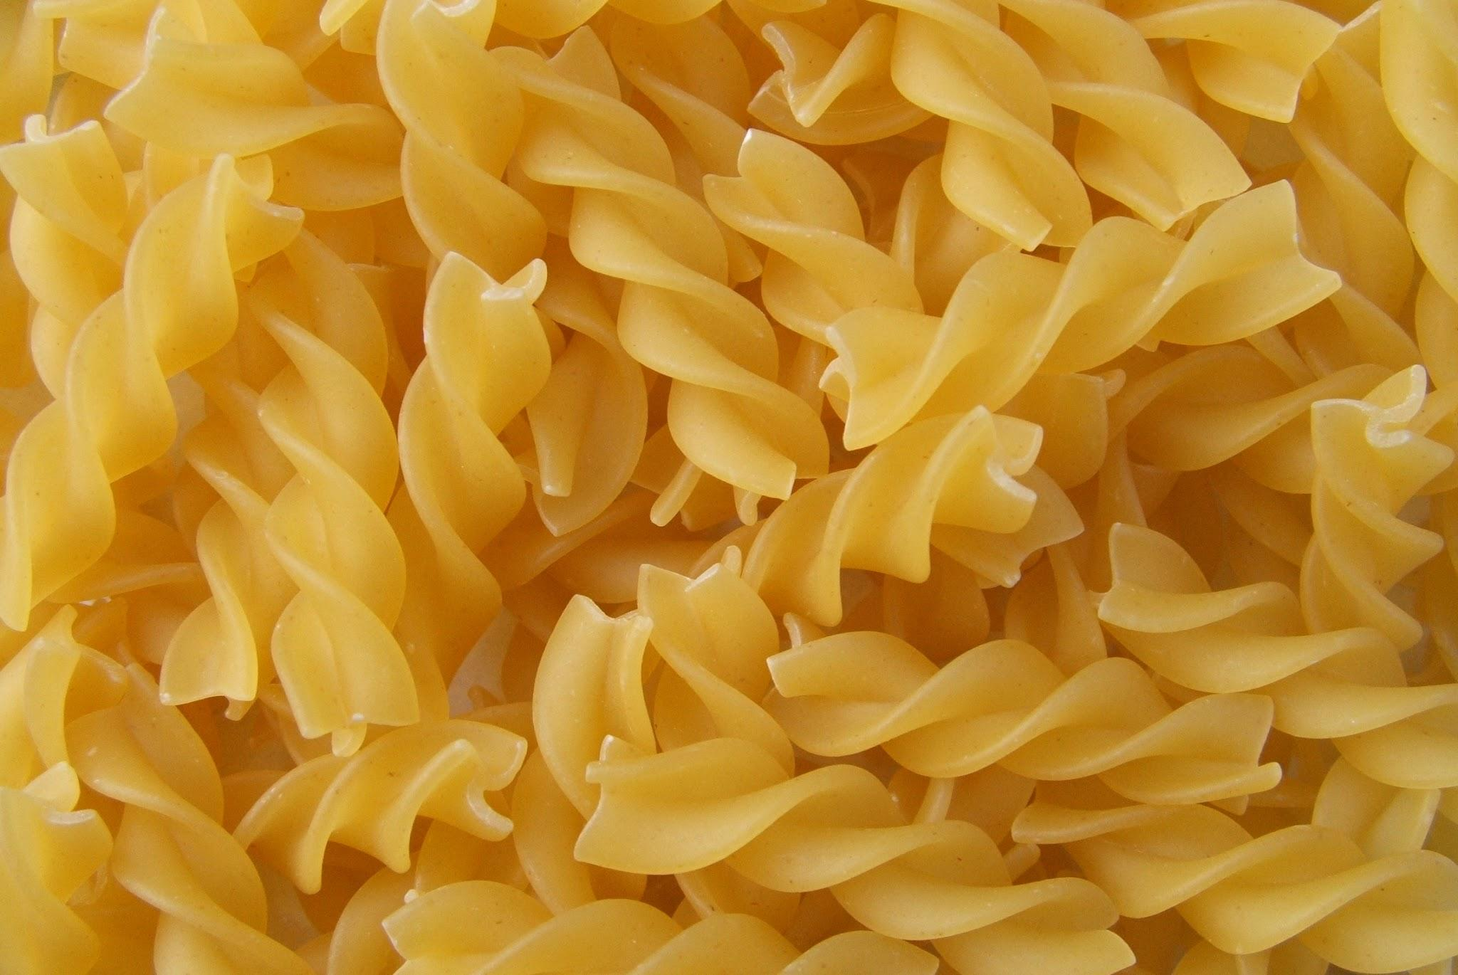

The Average American consumes 55% of their daily calories from Ultra-Processed Foods.

Slide 13

FORTIFICATION

Slide 14

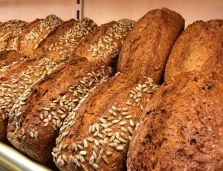
THE DIRTY TRUTH
Adding Vitamins and Minerals to food that the process of making the food, has resulted in stripping its nutrients. Less nutrient dense.
Whole Wheat contains B vitamins, thiamin, folate, fiber, iron, magnesium, antioxidants like Vitamin E.

Slide 15
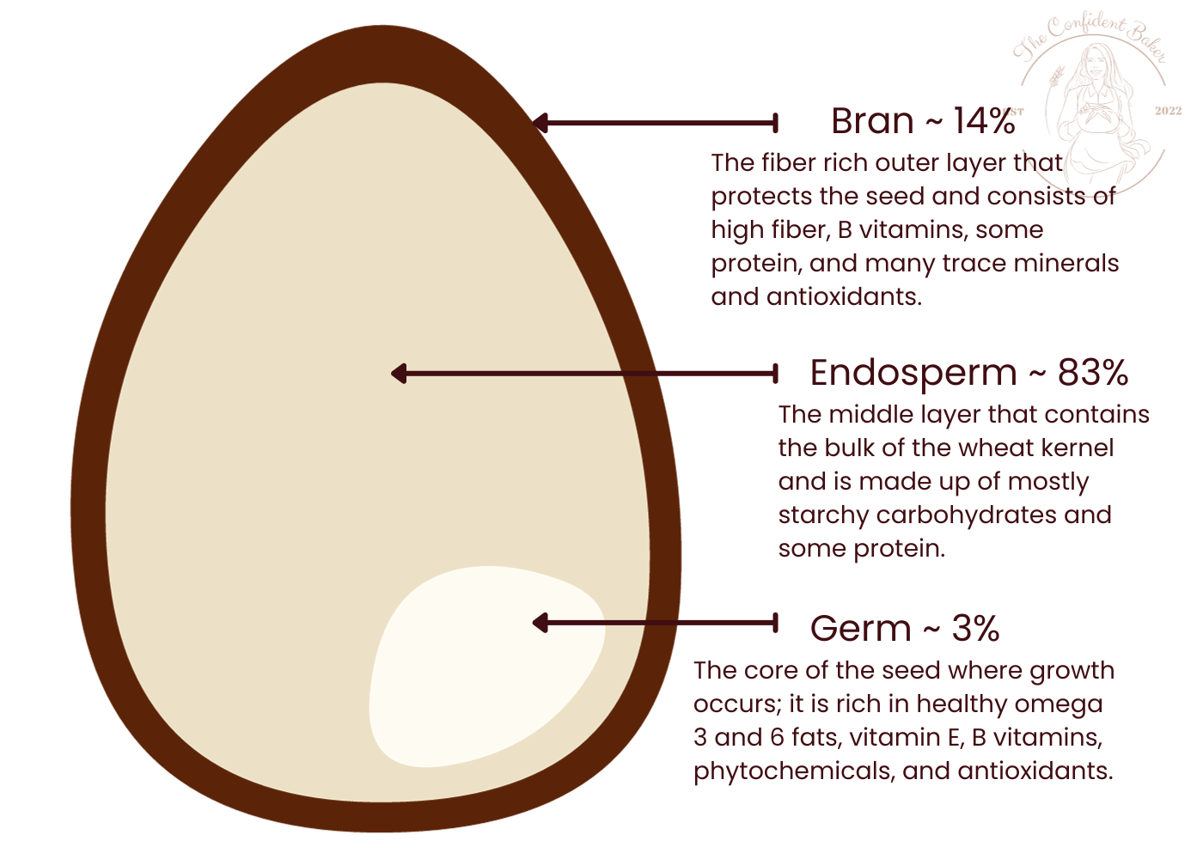

Slide 16


Slide 17

What Can We DO Now?
Be aware of deficiencies!
Vitamin D, B, Iron, etc. Hydration
Sleep
Movement

Slide 18
Think: food is the means to our goal for longevity
Pay attention to how you feel after you eat
Get nutrients for meat and vegetables and fruit
Consume protein - 1 gram per pound of body weight

Slide 19
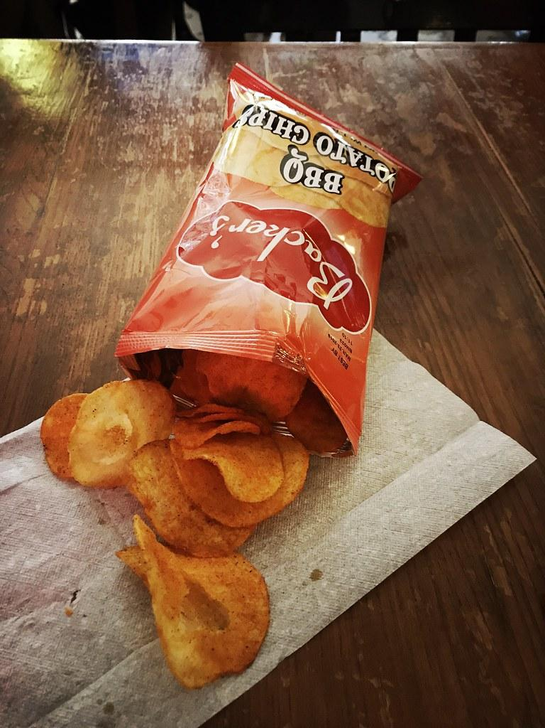

PLAN FOR HUNGER!

Slide 20
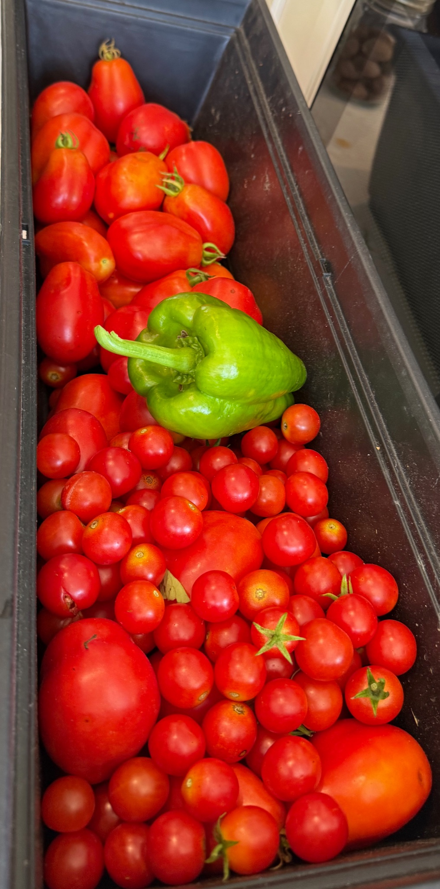

What is planned is possible!

Slide 21


Train
For
Life

Slide 22

No pain, no gain
More Sweat = better workout
Cardio is the only way to burn fat
Crunches = six pack abs
Cleaning the house is a functional workout

Slide 23
How do we train for longevity?
Avoid ultra-processed foods & Sugar
Prioritize protein
Know your stats
Train with a plan for a purpose
Aging is inevitable, plan for it.

Slide 24


Slide 25

Resources
Mike Matthews: LegionAthletics.com
Sugar Crush- Dr. Jacoby
The Power of Habit- Duhigg
The AutoImmune Solution- Dr. Amy Myers
Roar- Sims
The Wahls Protocol- Dr. Wahls https://terrywahls.com/

Slide 26
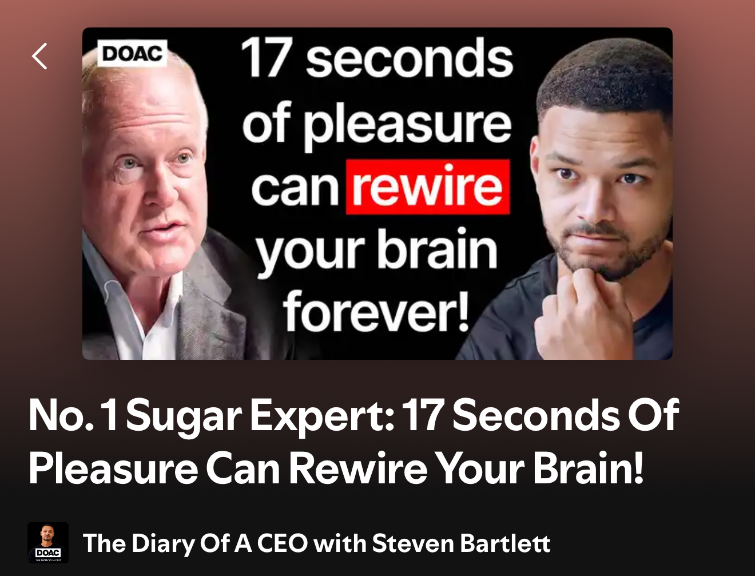

Resources: Podcasts
*Dr. Gabrielle Lyon Show
*Foodtrainers
*Realfoodology
*Huberman Lab
*The Peter Attia Drive Podcast
* The Diary of a CEO
With Dr. Robert Lustig

