Slide 1


Programs & Perspectives: A National Overview
The Big “I” Has Your Back

Slide 2

Presentation Summary
Advocacy
Market Access
Other Big “I” Benefits

Slide 3
Advocacy/Govt Affairs
The industry’s most powerful and respected advocate in federal government affairs.
Big “I” team recognized annually by The Hill newspaper as “Top Lobbyists” in DC.
Support for state government affairs in state capitals and representing independent agents with NAIC and NCOIL.
The Big “I” is the only industry trade association that has boots on the ground in every state capital, every state legislative district, and every congressional district.
Advocacy with carriers, regulators, critical vendors, ISO, ACORD and others.

Slide 4
Top Federal Govt Affairs Issues
Maintain favorable tax policy.
Address legal system abuse.
Support federal efforts to address market dysfunction from natural disaster risk including wind, water & wildfire.
YOUR voice on federal insurance programs including NFIP, FCIP, etc.

Slide 5
Update on Government Funding
A partial federal government shutdown began on October 1 after Congress failed to agree on a new FY2026 funding deal.
Roughly 750,000 federal employees have been placed on furlough. “Essential employees,” including active-duty military members, will be required to work despite not getting paid.
The House has passed a continuing resolution to keep the government open through November 21, giving Congress more time to complete 12 spending bills.
However that continuing resolution needs 60 votes in the Senate and has repeatedly come up short, with Democrats holding out to negotiate the continuation of increased Affordable Care Act subsidies from the pandemic.

Slide 6
National Flood Insurance Program
The NFIP authority lapsed on October 1.
FEMA still has authority to ensure payment of valid claims with the funds it has on hand. Existing policies are allowed to remain in effect until they expire (i.e., the renewal date plus a 30-day grace period).
Renewal of policies is allowed if the application was received prior to September 30th and the premium is received within the 30-day grace period.
The federal government’s requirement to purchase flood insurance if the property is in a flood zone is suspended and lenders can decide whether to make loans in flood hazard zones.
A broad coalition of organizations representing the insurance, real estate and banking industries sent a letter to Congressional leaders, urging their quick action to extend the NFIP.
The Big "I" will continue to advocate for NFIP reauthorization, either through a continuing resolution or another avenue.

Slide 7
Tax Reform – A Big Win for Big “I” Agencies
According to the 2024 AUS, 86% of Big “I” members are organized as pass-through entities.
Individual rates remain in place with a top tax bracket of 37% while modifying the inflation adjustment for various tax brackets.
The 20% deduction (Section 199A) for pass-throughs was made permanent.
In 2018 the Big “I” worked to make sure IAs were not considered “specified services” and therefore able to take full advantage of this provision.
No changes to the U.S. corporate rate of 21%, which TCJA made permanent.

Slide 8
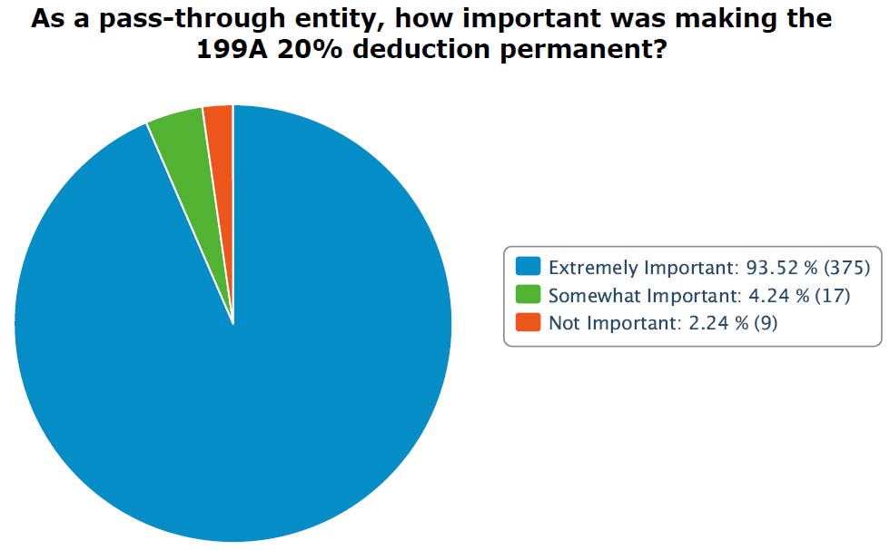
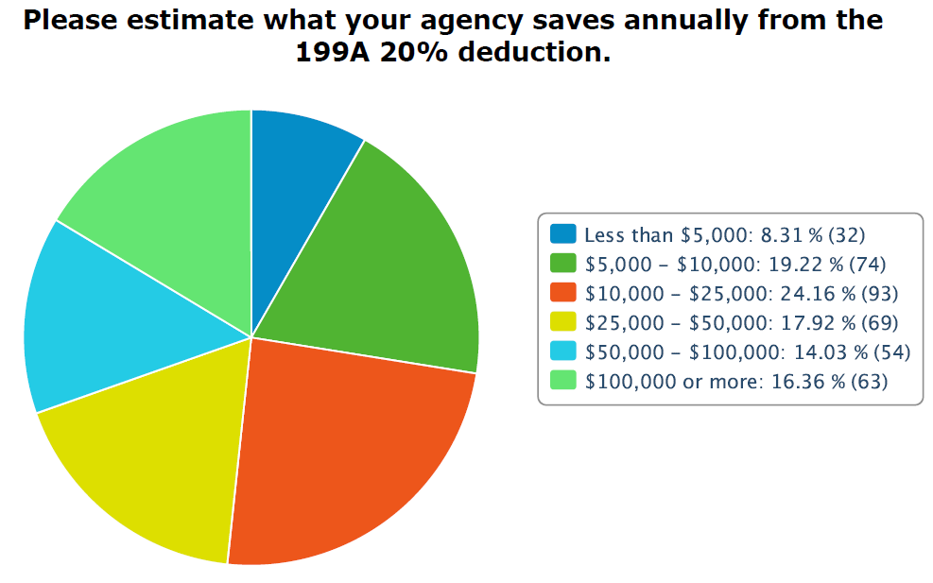
Yearly Savings According to 2025 IIABA Member Survey
Data collected from a survey of 402 pass through agencies in September 2025.

Slide 9
Tax Reform – A Big Win for Big “I” State Associations
The House tax package originally included language to subject tax-exempt organizations’ royalty income to the unrelated business income tax (UBIT) – 21%.
The Big “I” led the coalition efforts on this issue and successfully worked with the Ways & Means Committee Chair and House Republican leadership to remove that entire section of the bill.
According to the 2023 990 disclosures and information states provided, subjecting royalty income to UBIT would have cost Big “I” state associations approximately $2 million annually.

Slide 10
Third Party Litigation Funding
Third Party Litigation Funding (TPLF): when an outside agent – someone not involved in the legal dispute – pays a plaintiff’s legal fees with the expectation of financially profiting off any settlement or judgment. It is a growing multibillion-dollar industry with sophisticated investors threatening the integrity of the U.S. court system.
An estimated $15.2 billion in assets were allocated to U.S. commercial litigation investments in 2023, and a separate analysis predicts that commercial litigation funding could reach $31 billion in the U.S. by 2028.
In many cases third-party litigation funders pay a more favorable tax rate on their share of a court award than the injured plaintiff. This perversely incentivizes foreign investment in U.S. litigation. The Big “I” supports efforts to close this tax loophole that foreign and domestic TPLF investors exploit.
Sophisticated investors treat our court system like a casino.

Slide 11
Third Party Litigation Funding contd.
When legislative text for the Senate tax bill was released in mid-June, it included a Big “I”-supported provision that would tax third party litigation funding (TPLF) proceeds at a 40.8% rate.
Litigation finance firms and the plaintiffs’ bar launched an aggressive campaign to strip this provision, reportedly spending tens of millions of dollars over a three-week period. The Senate parliamentarian ultimately stripped the provision due to procedural reasons.
Despite this setback, the Big "I" actively supports two bills tackling different aspects of the issue:
The Litigation Transparency Act of 2025 (H.R.1109) requires disclosure of third-party litigation funding (TPLF) agreements and payments in civil lawsuits.
The Tackling Predatory Litigation Funding Act (S. 1821/H.R.3512) would close the TPLF tax loophole.

Slide 12
Combatting Legal System Abuse
Independent insurance agents & brokers, as respected members of their communities and trusted advisors to their customers, have a special role to play in the education and advocacy needed to combat legal system abuse.
Education and Awareness Successful advocacy begins with education. Remain aware of priority topics and use brief talking points with legislators and clients. Explain the effects that LSA has on both availability and affordability of insurance.
Working Together Successful advocacy relies on the power of numbers. Legal system abuse is an issue facing every policyholder – both personal lines and commercial.

Slide 13
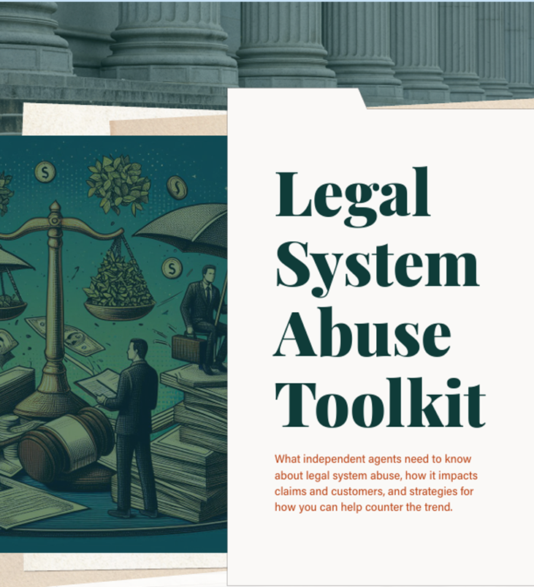
Resources for Independent Agents
The Trusted Choice Legal System Abuse Toolkit equips independent agents with the information they need on this issue. The toolkit includes tip sheets to help explain the various impacts of legal system abuse, quick-reference information; and infographics and videos designed to help make complex information easy to understand and share.

Slide 14


Slide 15
Natural Disaster Risk Efforts
Natural disasters are becoming more frequent and more severe, straining p&c markets. Without effective mitigation, insurers face rising claim costs, homeowners struggle with skyrocketing premiums or lack of coverage, and the federal government is forced to step in with costly disaster relief programs.
The Big "I" supports pre-disaster mitigation efforts, including the Fix Our Forests Act (S.1462/H.R.471), the Disaster Resiliency and Coverage Act of 2025 (H.R.1105), and the Disaster Mitigation and Tax Parity Act of 2025 (S.336/H.R.1849).
The Big "I" is assembling a coalition of insurers, realtors, home builders and other stakeholders to advocate for disaster mitigation legislation.

Slide 16
Federal Insurance Programs
National Flood Insurance Program (NFIP): The Big “I” supports NFIP modernization to increase take-up rates, while opposing any policies that would harm the Write-Your-Own (WYO) Program (including WYO reimbursement reductions).
Federal Crop Insurance Program (FCIP): Congress is working to pass a new 5-year bill that is expected to top $1.5 trillion with crop insurance accounting for approximately $100 billion, the second largest funding allocation. The Big “I” is working to protect the FCIP and agent compensation from any cuts.
The Big "I" supports legislation to eliminate the Federal Insurance Office (FIO), which has shown questionable value since its creation.
The Terrorism Risk Insurance Act (TRIA) is currently scheduled to expire on December 31, 2027.

Slide 17
2025 Legislative Conference
Nearly 1,000 attendees – agents, brokers, company executives, association staff and industry partners – joined the Big "I" in Washington, DC April 30 – May 2.
Attendees met with nearly 400 Congressional offices (out of 535). West Viginia agents met with all 4 Congressional offices.
Guest speakers included House Majority Leader Steve Scalise (R-LA), Rep. Scott Peters (D-CA), Sen. Steve Daines (R-MT), NRCC Chair Richard Hudson (R-NC), Rep Bill Huizenga (R-MI) and Rep. Grace Meng (D-NY).
Save the date for the 2026 Big “I” Legislative Conference: April 22-24.

Slide 18
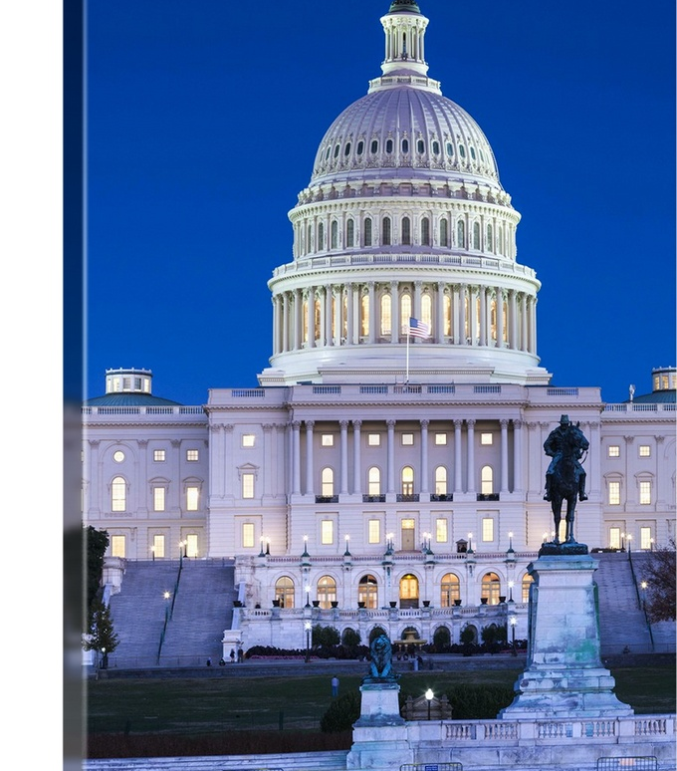
InsurPac One of the largest and most recognized PACs on Capitol Hill. In the 2024 U.S. election, InsurPac disbursed over $2.5 million to a total of 278 federal campaigns, winning 268 of them for a 96% victory rate. Let’s grow InsurPac! If each agency gives $100 = $4 million If each agency gives $250 = $10 million Visit www.InsurPac.com

Slide 19
InsurPac in West Virginia
In 2024, WV ranked 45th in total raised and 38th in $$/agency
2024 Major Donors:​
Centennial Club ($1000-$2499): Terri Dodrill & Ross Johnson
 | InsurPac $$ | $$ Per Agency | # Donors
2023 | $5,620.00 | $69.38 | 14
2024 | $4,750.00 | $58.64 | 9
2025 YTD | $5,900.00 | $68.60 | 9

Slide 20
2026 Midterm Election Outlook
The President’s party almost always loses House seats in midterm elections — 20 of the past 22 midterms since 1938. Since 1958, the President’s party loses an average of 4 Senate seats in the midterm.
Presidential job approval is critical: Net negative approval ratings a year before midterms have always led to losses for the President’s party. With a job approval of 46 percent, according to the RealClearPolitics polling average, Trump is more popular than he was at this point in his first term.
Midterm Turnout: Risk of a repeat of 2018: Democrats energized, Republicans less motivated.
Redistricting factor: GOP gains from new maps (e.g., Texas, Ohio, Missouri) are likely to more than offset losses in California if redistricting moves forward there.
Bellwethers: NJ & VA - mid-term prospects are historically foreshadowed by two “off-year” gubernatorial elections.

Slide 21
U.S. Senate
U.S. House
Republican Control: 53-47
Democrats need a net gain of 4 seats to flip the Senate
Only one-third of seats are up each cycle.
Competitive Seats: 34 seats up for reelection this year
22 Republican / Competitive: ME, NC, & OH
13 Democrat / Competitive: GA & MI
Only one Republican seat (Collins–ME) is in a state that Harris won, while two Democrat seats (Ossoff–GA & MI open) are in states Trump won.
Republican Control: 219–214 (2 vacancies)
Per Cook Political, 68% of House Republicans were elected since Trump first took office in 2017, and the lion’s share — including 201 of 220 House Republicans, won with Trump’s endorsement.
Competitive Seats: Democrats are playing offense in approximately 39 districts; Republicans in approximately 30 districts.
Mid-decade redistricting may also boost Republican strength by a net of 5-7 seats.
Notes:
https://www.brookings.edu/articles/what-history-tells-us-about-the-2026-midterm-elections/

Slide 22
Insurance Campaign Institute
Placing more insurance professionals in elected office is critical to shape public opinion and to enact good policy.
Objective: recruit, train and equip insurance professionals with the knowledge to run and win campaigns for elected office.
Candidates will come from the insurance industry (agents, brokers, underwriters, CSRs, company personnel, spouses & family, etc.), have a strong business orientation, regardless of party affiliation, and desire to run for elected office.
The program is open to individuals seeking office at any level of government – local, state, or federal.

Slide 23
Insurance Campaign Institute contd.
The Institute is essentially a boot camp training program conducted over one full day, is comprehensive and will cover topics such as:
Campaign organization, fundraising, polling, grassroots mobilization;
Social media, messaging and advertising; and
How to put the insurance community to work for you.
The only cost to participants will be transportation to/from DC.
The Institute will be conducted yearly with the inaugural program taking place prior to the 2026 Big “I” Legislative Conference (April 20-21).
The Campaign Institute, working with IIABA state associations and industry partners, will identify prospective candidates (regardless of party affiliation) to participate.

Slide 24
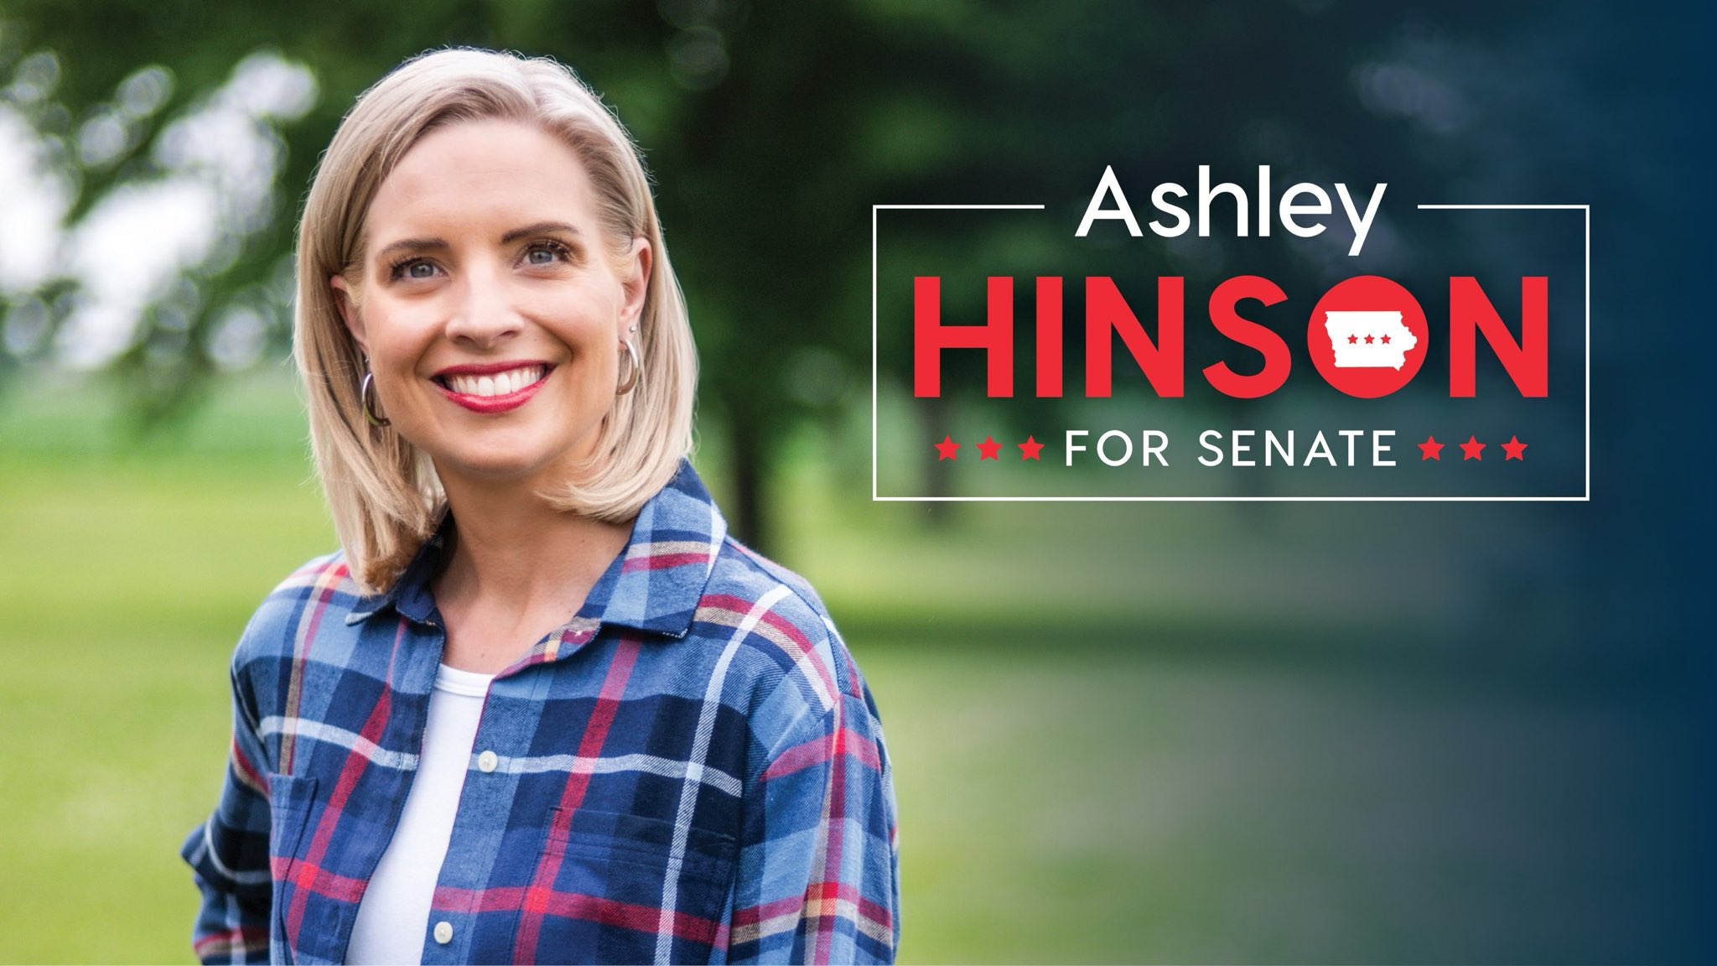
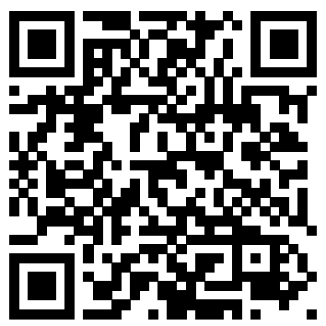
U.S. Rep. Ashley Hinson (IA-02) running for U.S. Senate
Ashley has largely cleared the primary field and received endorsements from the President, Senate Leadership and many prominent officials in the state.
If we can get her across the finish line, she will immediately become one of the most knowledgeable Senators on insurance issues.
We want to show Ashley how much support she has from the independent agent community, and we have already begun fundraising on her behalf. We hope you’ll consider joining us with a contribution of any amount:
https://secure.anedot.com/ashley-for-iowa/bigi

Slide 25
Industry Advocacy
Carrier Meetings & Coalitions: Big "I" is key leader in carrier meetings and coalitions on hard market and other top insurance issues such as legal system abuse.
Advocacy Forums: Big "I" leaders represent IA voice in various industry speeches, panels, webinars and podcasts on hard market challenges.
Industry leader on independent agency channel insights, info and analysis:
Renowned biennial Agency Universe Study
Annual IA Market Share Report
Annual Best Practices Study of top performing agencies

Slide 26
Big “I” Alliance
NEW! Best-in-class market access for agency members
Replaces (Blue) and expands (Gold) upon Big “I” Markets
3 tiers for participation with placements and appointments options
Provides start-ups and smaller agencies market access to top national carriers, helping agencies work their way up to rewarding appointments
Agencies that can obtain acceptance by carriers under master codes
Direct access to carrier systems/reasonable volume requirements
Expanding with new carriers/increased commissions

Slide 27
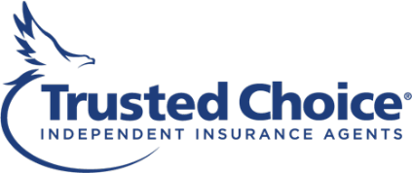
Trusted Choice®
Marketing-in-a-box resources for YOUR agency.
Legal System Abuse Toolkit: Summer 2025! Nuts-and-bolts guide to navigating legal system challenges.
Expanded Hard Market Toolkit: More than 10,000 downloads!
AI Toolkit: Guidance on how and where agencies can use AI for marketing, SEO and more.
Social Media Content: Ready-to-use content for independent agents and additional scheduling through Social Jazz.
Digital Performance Hub: Free custom agency dashboards to track website analytics.
Popular Insurance Explained video series: New insurance primers to share with customers.

Slide 28
Big “I” Programs
Invest: Educational foundation fostering the next generation of industry talent
Young Agents: Networking and training opportunities
Diversity: Leading the way in diversity & inclusion with agents
Big “I” Hires: The industry-leading recruitment, retention and HR resource
Best Practices Program: Real-life benchmarking and formulas for agencies of all sizes
Big “I” E&O: Your source for the best E&O available to independent agencies with partner Swiss Re
Technology: ACT/Catalyit/101 Weston Labs

Slide 29
Other Big “I” Benefits
Legal, tech and financial help when and where agents need it most.
Company appointment contract reviews from the Big “I” in-house legal team.
Massive data and technology upgrade: New robust association management system (AMS) integrating with a new content management system (CMS) and website platform at national. Opportunities for state integrations/upgrades. For members: better data, targeted communications, easy-to–find resources.
Bobby Salmon Big "I" Relief Fund—assisting member agencies in their greatest time of need after disasters and other crises.
InsurBanc: Created by and for independent agencies for range of financial needs.

Slide 30
Communications
Keeping you on top of industry and association news to help your agency thrive.
Award-winning monthly magazine, Independent Agent.
Weekly e-newsletters on markets trends, new products, industry headlines & association announcements.
Popular Agency Nation Radio podcasts -- including award-winning hard market bonus series produced by and for young agents ...and new series on AI.
All new websites: independentagent.com and iamagazine.com

Slide 31
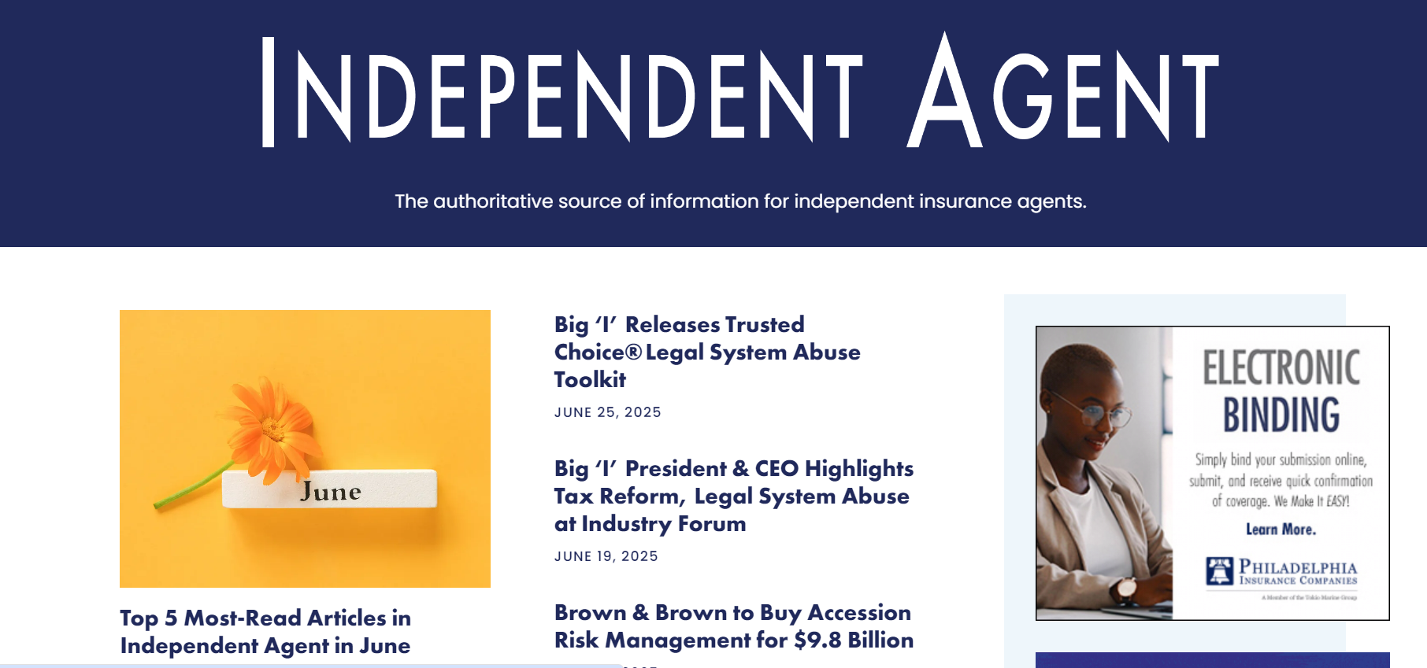
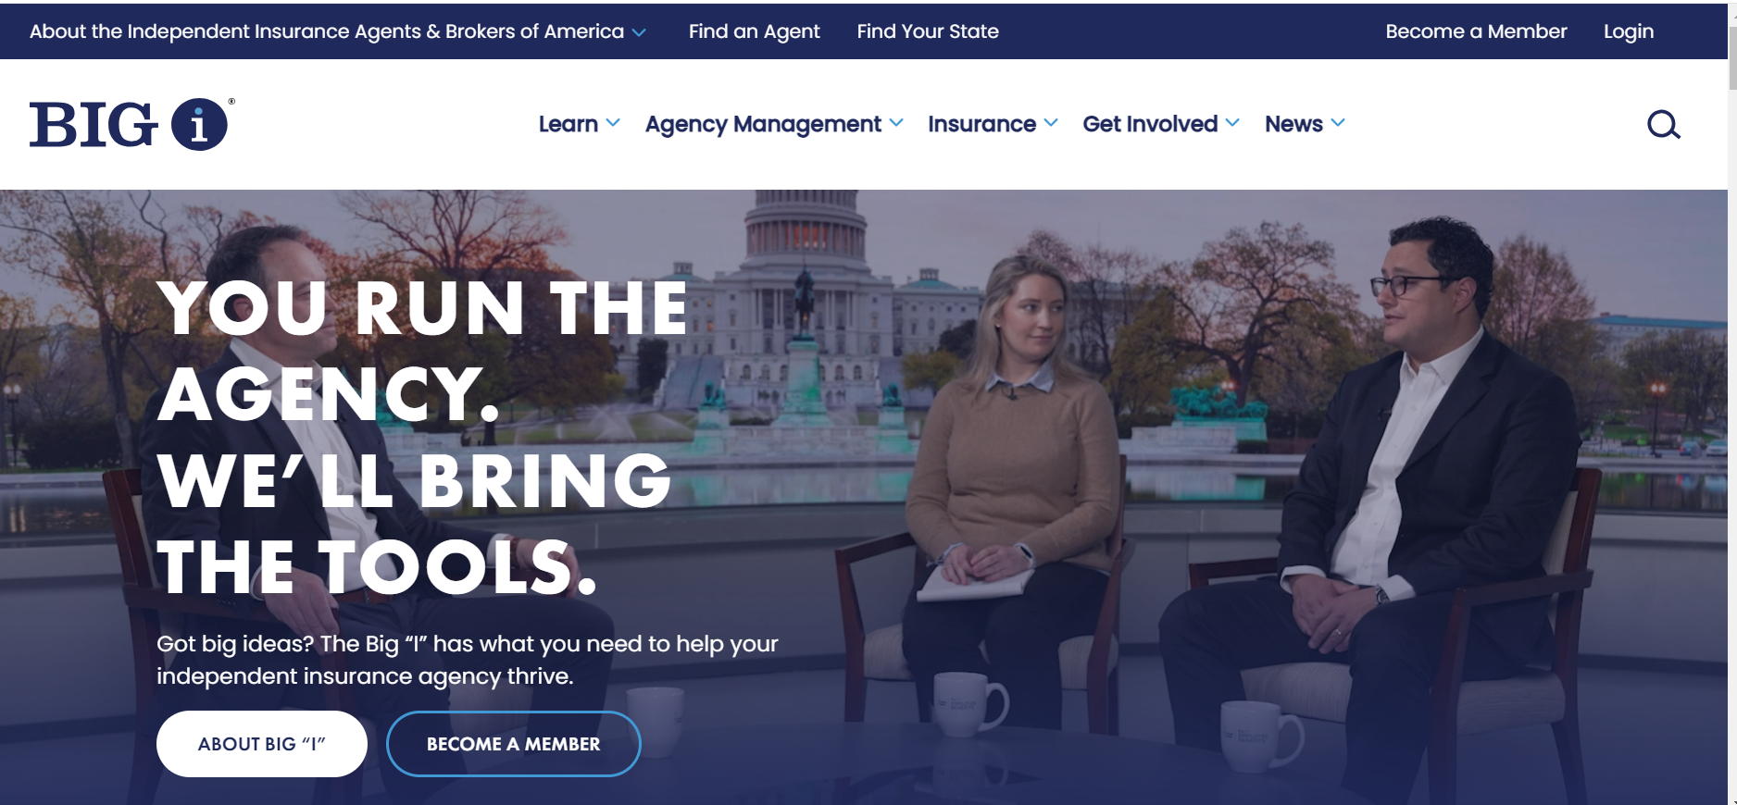
New Big “I” Websites Easier navigation | Modern design | Related content links | Better user experience
independentagent.com
iamagazine.com

Slide 32

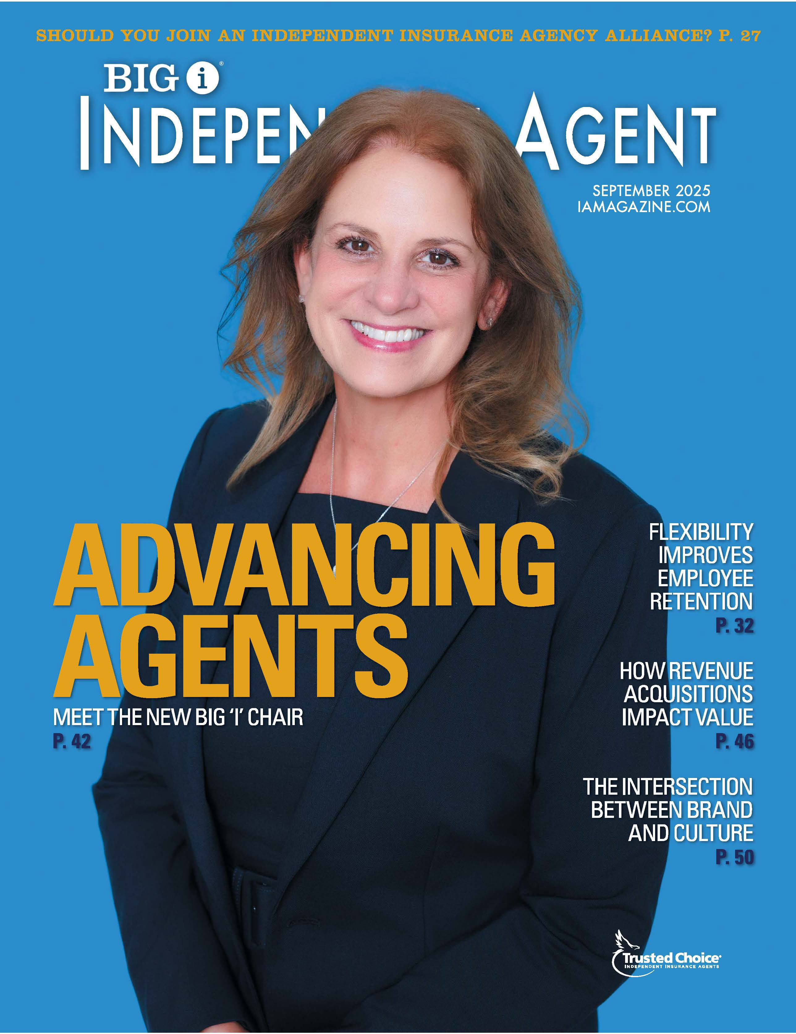
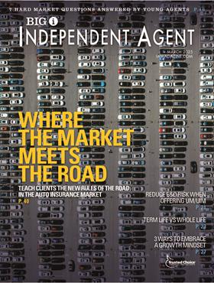
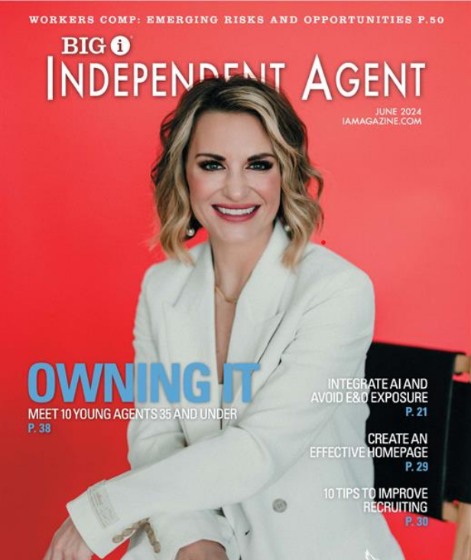
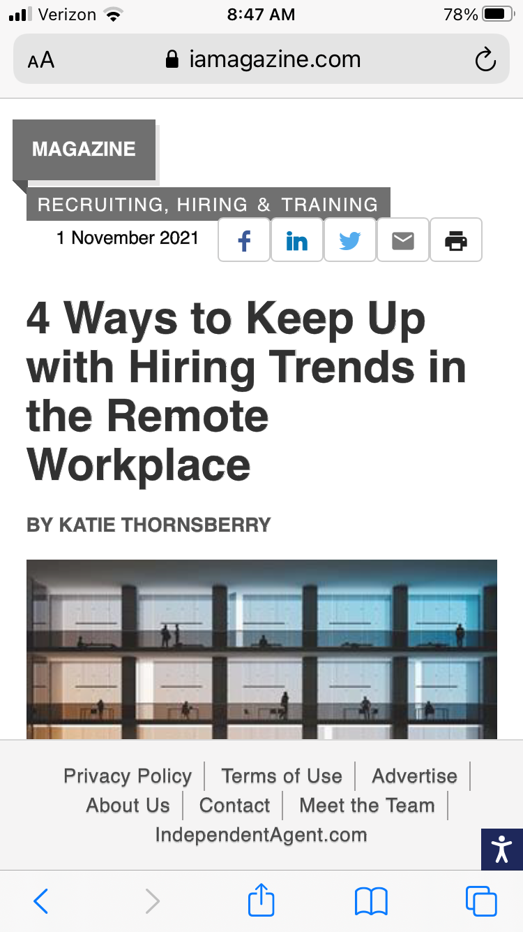
Independent Agent Magazine
Print Edition
Big “I” flagship publication
Gold standard in insurance industry news for agents
Circulation: 38,000
Winner of many business publication awards in last 3 years
Digital Edition
Easy to read
Mobile- and tablet-friendly
New ad/sponsor opportunities
Improved keyword search function

Slide 33
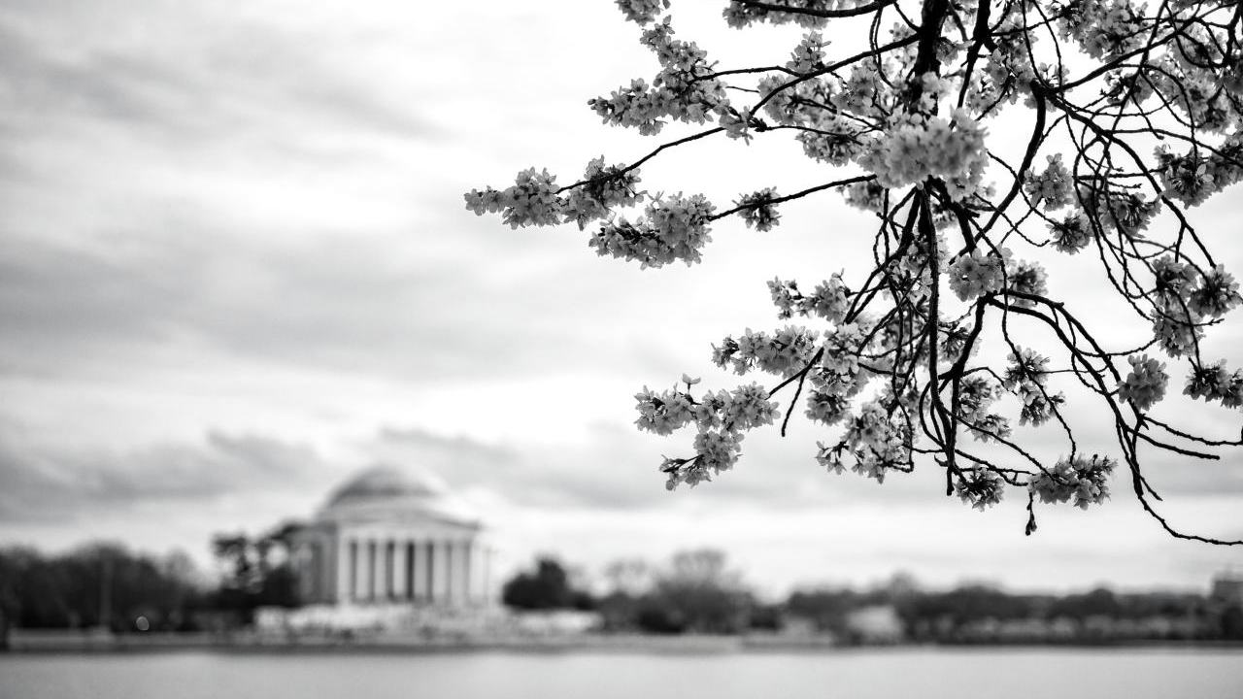
THANK YOU.
The Big “I” Has Your Back

