Slide 1



September 8, 2025
October 8, 2025
Jason Pizatella
Chief Executive Officer
Contractors Association of West Virginia

Slide 2





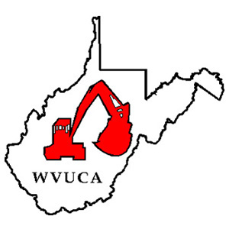
ABOUT CAWV
OUR MISSION: We serves our members, the construction industry, and the general public through communication, education, representation, and promotion.
OUR VISION: CAWV is the only full-service trade association representing every aspect of the West Virginia construction industry including heavy/highway, building, and utility contractors and those who support them. We have over 500 members employing over 22,000 men and women who are “Hard at Work” building a better West Virginia.

Slide 3


2023
Centennial Anniversary

Slide 4
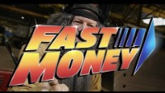
FAST MONEY
By the Associated General Contractors of Oklahoma

Slide 5
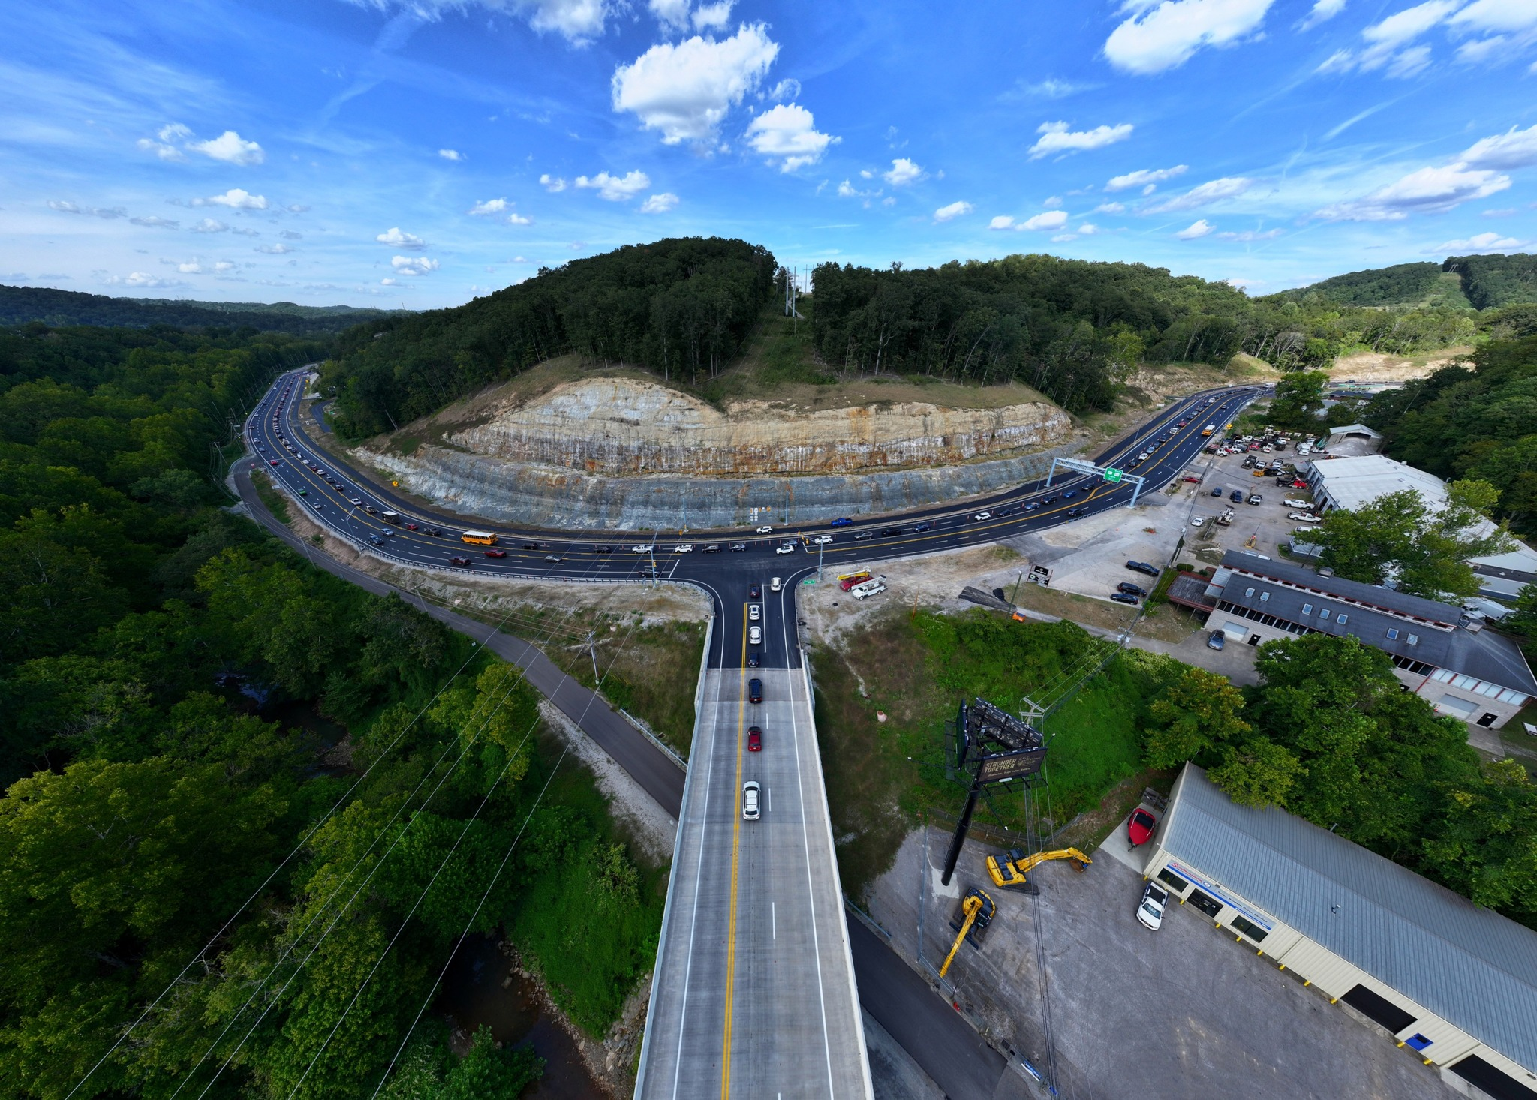

Slide 6
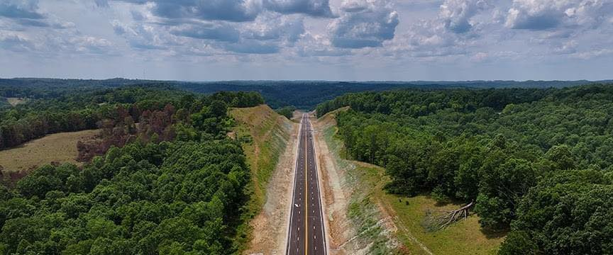

Slide 7
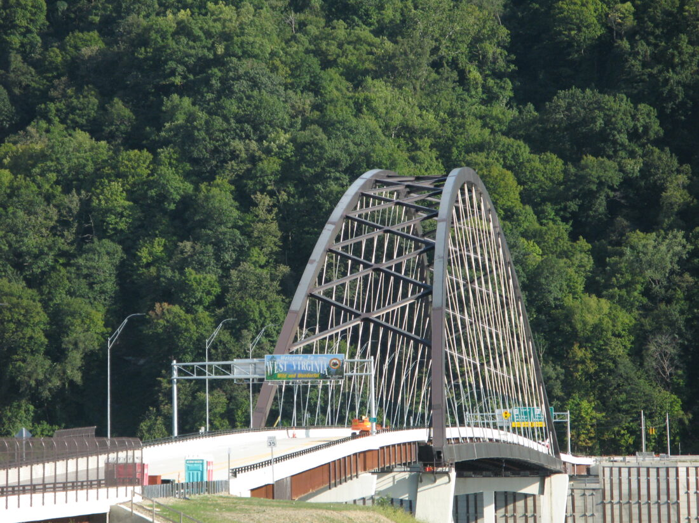

Slide 8
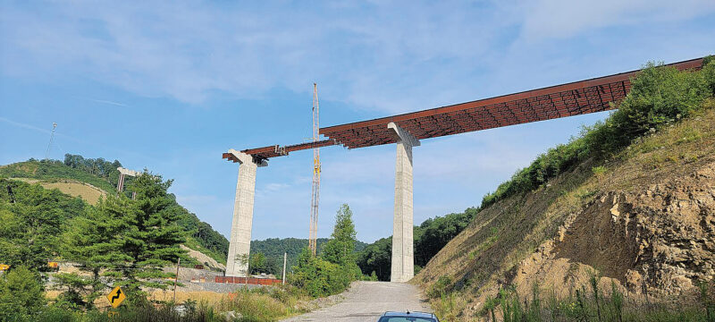

Slide 9
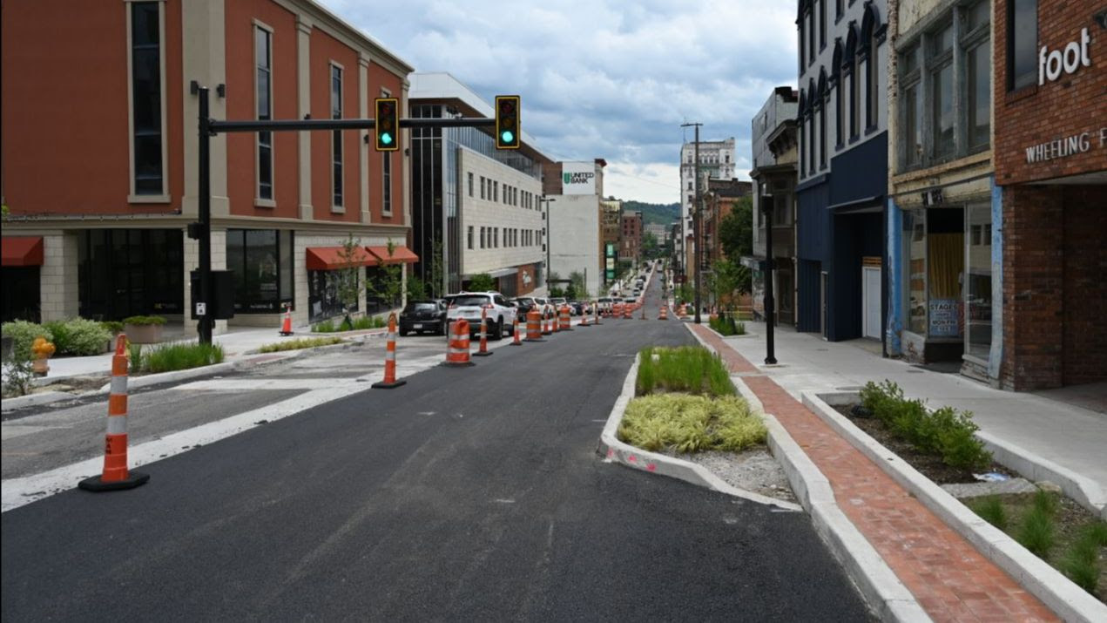

Slide 10
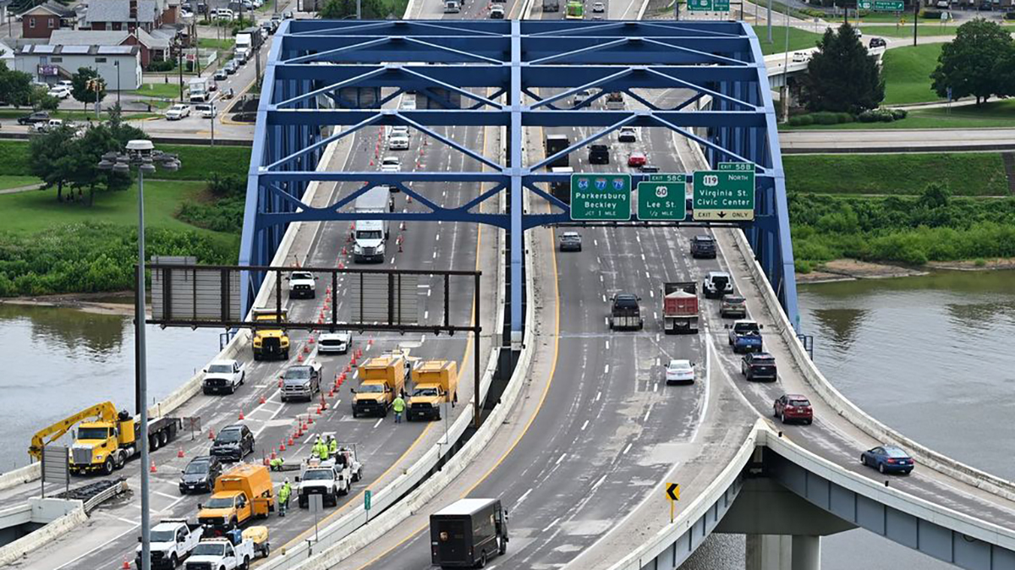

Slide 11


Slide 12


Slide 13
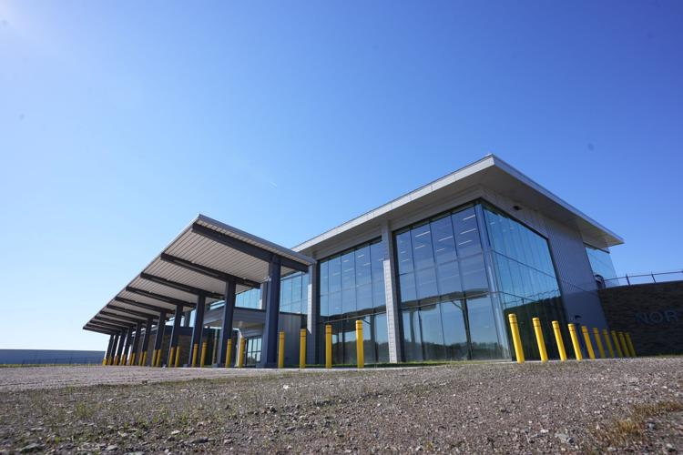

Slide 14


Slide 15
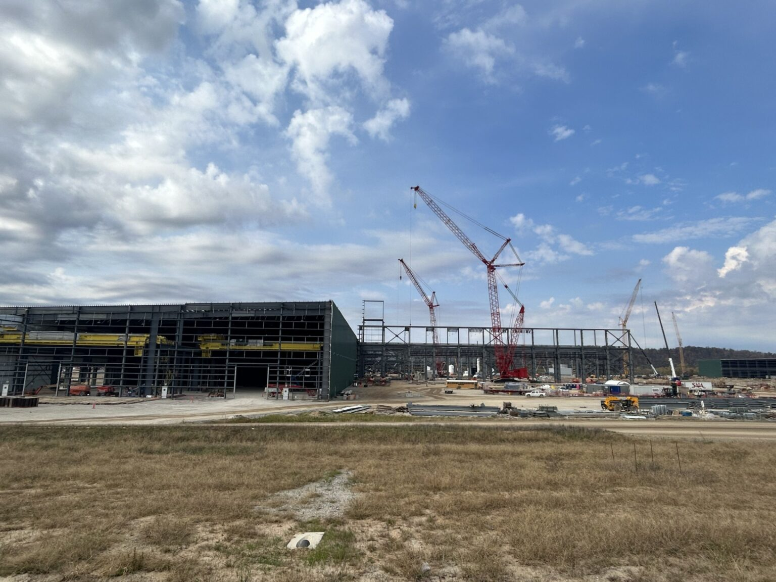

Slide 16
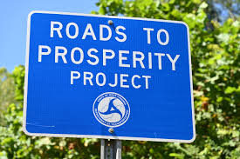
Roads to Prosperity
Authorized by West Virginia voters in October 2017, the Roads to Prosperity program invested $2.8 billion in road and bridge construction and maintenance throughout West Virginia.

Slide 17
The ORIGINAL Big Three
• Corridor H
• King Coal Highway
• Coalfields Expressway

Slide 18
The REAL Big Three
• Infrastructure Investment and Jobs Act
• Inflation Reduction Act
• Fiscal Responsibility Act of 2023

Slide 19
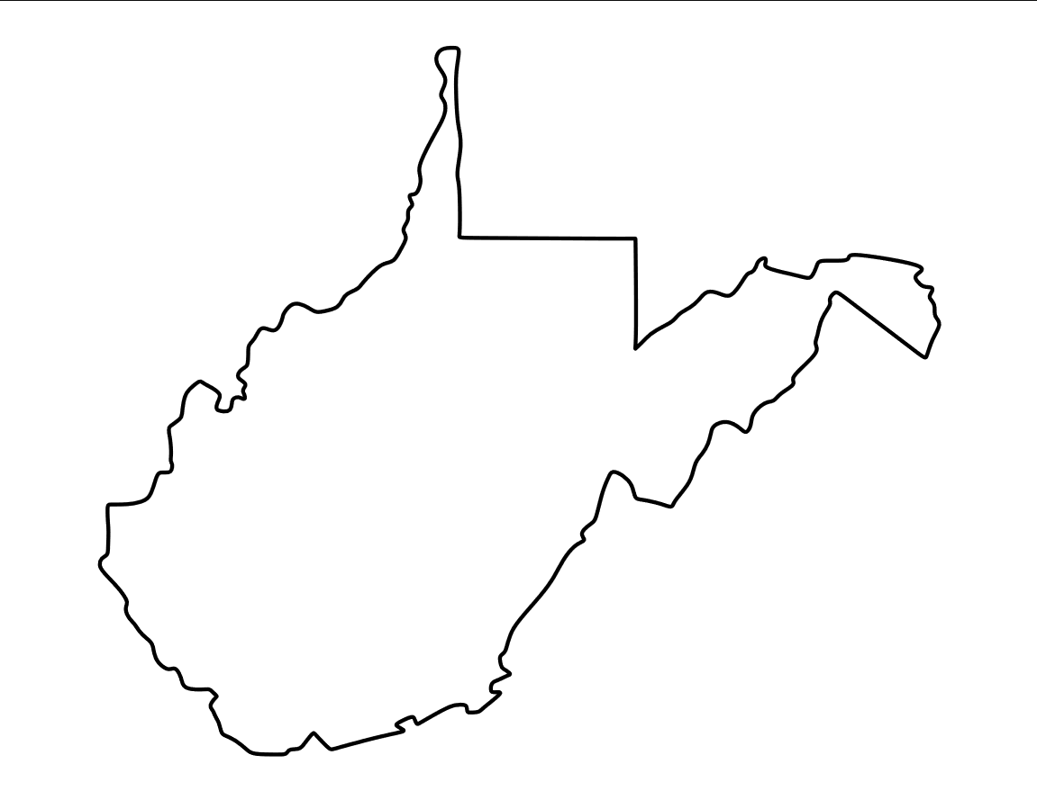
Infrastructure Investment and Jobs Act
West Virginia Allocation

Slide 20

The Importance of Surety Bonds
Surety bonds ensure the completion of public projects.

Slide 21
Challenges Ahead
• Construction Work Zone Safety
• Uncertainty over Tariffs
• Successor for the Infrastructure Investment and Jobs Act
• Future of the Federal Highway Trust Fund and Motor Fuel Excise Taxes
• Federal Permitting Reform

Slide 22

Number One Challenge:
Workforce Recruitment and Retention

Slide 23

Why the Construction Industry?

Slide 24

Questions?
Jason Pizatella
Chief Executive Officer
Contractors Association of West Virginia

