Slide 1

Connecting with Your Clients: Social Media Marketing that works for your Agency
Kristin Meeks
www.wvsocialmedia.com

Slide 2

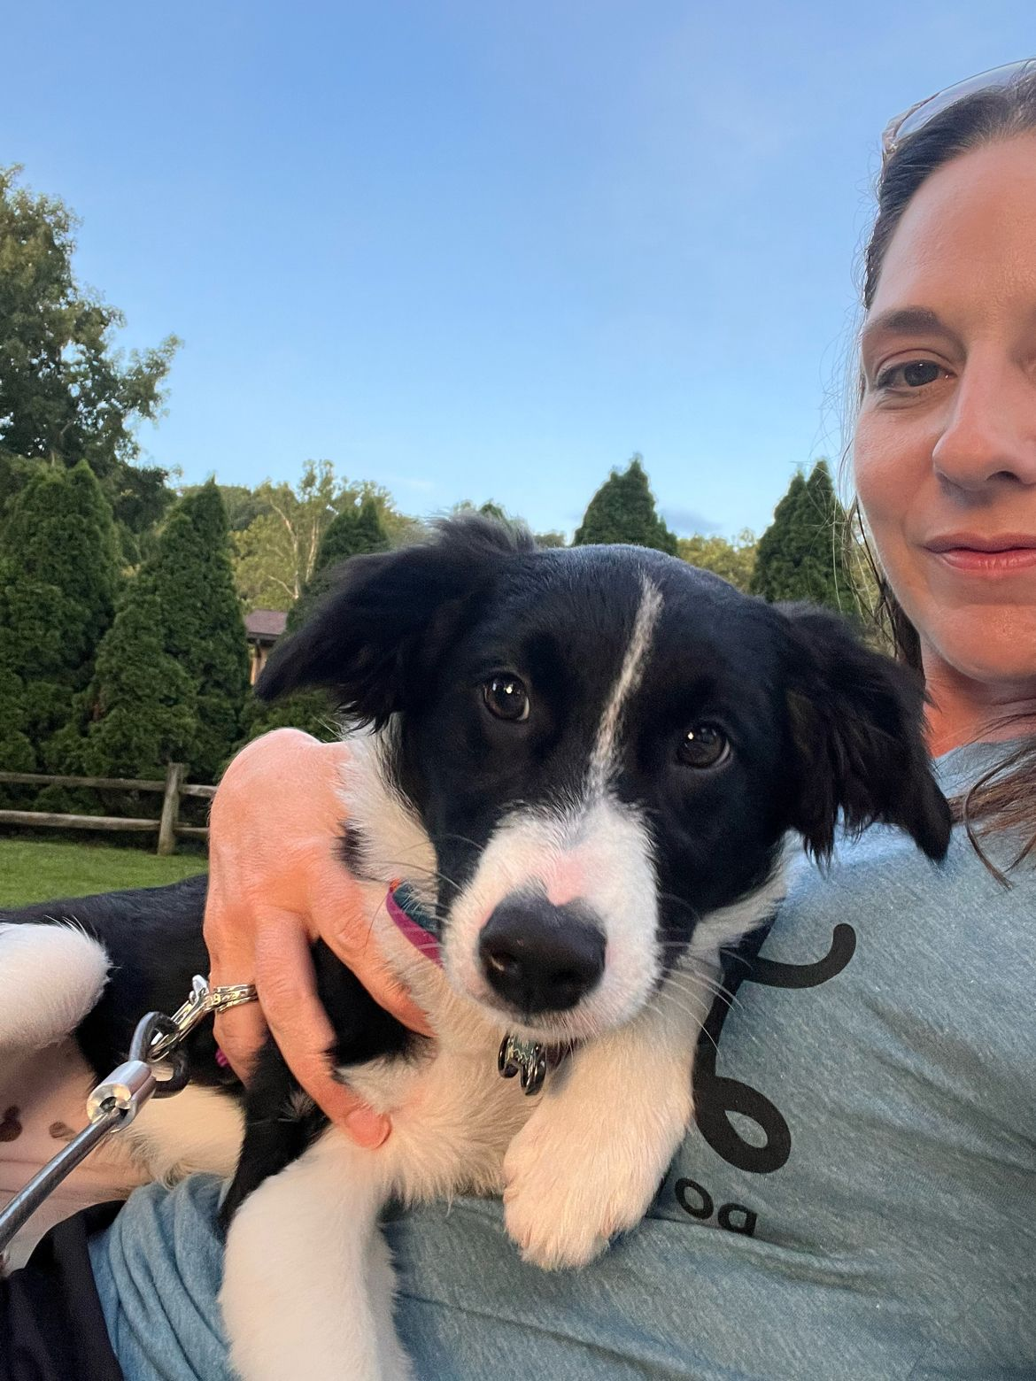
About Me
Marketing/Ad/PR degree from Marietta College
Masters in Integrated Marketing Communications from WVU
6+ years of higher education marketing/outreach experience
15 years of Entrepreneurship
19 years of higher education teaching experience
Chamber Board Member
Chair of the Board Entrepreneurship Program (Marietta College)
Past board member of Downtown PKB (Mainstreet Parkersburg), Belpre Chamber, Firefly-Spark of Hope, Advisory Committee to Nonprofits LEAD (Marietta College)
Program Advisor at Washington State of Ohio and Washington County Career Center
I’m a wife and a mom.

Slide 3
Agenda
Basics of Social Media for Your Agency
What Platforms are your Clients on
How do we know what is working?
Do’s and Don’ts of Social Media Posting

Slide 4

Why Social Media Matters
Huge Shift has happened in how clients find and trust businesses
Relationship building as moved online
Industry-specific benefits:
Humanizing agents
Building trust in a low-touch, high-trust service
Staying top of mind during life events (weddings, new homes, kids, retirement)

Slide 5

From Word of Mouth to World of Mouth
In the past, referrals from friends, family, or community groups were the #1 way people chose an insurance agent.
Today, digital referrals have taken over:
Google reviews,
Facebook recommendations,
LinkedIn endorsements,
social shares.
A client is far more likely to “Google you” or check your social media presence before they ever call.
Around 70% of consumers check a business’s online presence before making a purchase or scheduling a service
(HubSpot, 2024).

Slide 6
Why is Social Media is everyone job?
We are all content creators
We all have tiny computers in our hands
We are all photographers/videographers
Action item:
Write down what photos are currently on your phone that you could use to create content, make a note of who has access to your agency social media pages.

Slide 7
Where are your clients?
Facebook – community building & ads
LinkedIn – professional credibility & networking
Google- #1 search engine
How to decide:
Audience demographics,
local vs. broad reach,
content type

Slide 8
Content That Connects
Educate
Entertain
Engage

Slide 9
Content is King
What makes you follow a page?
You know the Business
The Business put out relevant information
The Business is entertaining
Content drives likes, engagement and shares

Slide 10
Educational Content
Positioning you as the expert
Explainer Posts:
life vs. term
auto coverage tips
pull info from website
Can you confidently say 90% of your website is accurate?

Slide 11
Entertainment
Entertain: relatable memes, seasonal posts
Storytelling strategies:
Share client stories (with permission) to show real impact
Employee spotlights: birthdays & anniversaries

Slide 12
Engaging Content
Visually appealing: canva.com
Branding tips:
Consistency,
Trustworthiness,
Approachable tone

Slide 13
If Social Media isn’t your only job….
Plan
Create a content calendar
Do you have to be on all the social media platforms?
Facebook
LinkedIn
Instagram

Slide 14
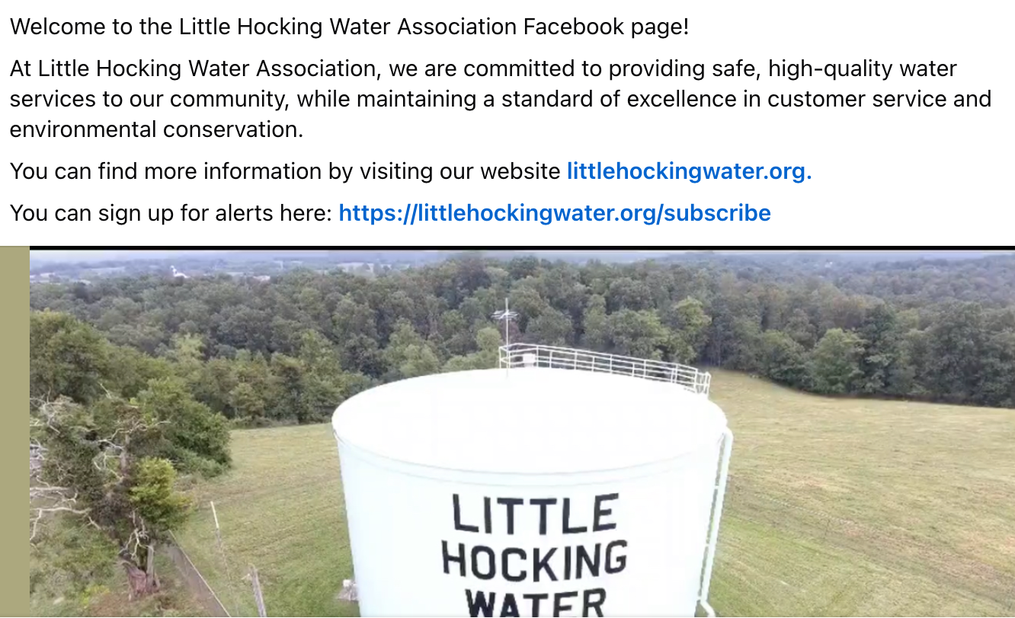
Basic Social Media Set Up
Is your Agency represented on your social media sites?
Logo (correctly formatted)
Agency info (hours, description)
Website/phone number (listed and correct)
Welcome Post
Action Item: Google Your Agency Name

Slide 15
Strategies that Work
Balancing organic vs. paid content
Posting frequency & timing (quality > quantity)
Using video & live sessions to build personal connection
Leveraging local community involvement (sponsorships, events, partnerships)
Reputation management: responding to comments, reviews, and DMs professionally

Slide 16
Organic v. Paid Content
Consistent relevant, engaging and entertaining content works without paid ads
When to use paid ads?
Specific campaigns
Short term solution
Pushing them to a website (capture more info)

Slide 17
Posting Times and Frequency
Generally Speaking:
First thing in the morning,
last thing before sleep
8am & 8pm
Insights: Exact times/types of content
Live Button (Facebook and Instagram)
Find insights: business.facebook.com

Slide 18
Video Strategy
Start with 1-2 videos a month
Face-time/Voice Over/music
Captions
Short form (under 90 seconds)
Vertical
Ideas:
Tips
Behind the scenes
If you go live, download and reuse

Slide 19
Community Involvement
Local Supports Local
Community involvement:
Sponsorships
Events
Partnerships
Make a list of events you participate in every year add them to your content calendar for social media.

Slide 20
Marketing Meets Customer Service
Reputation management:
Responding to comments
Reviews
Direct messages
Sales are made in the DMs.

Slide 21
Do’s and Don’ts of Social Media
Do Plan
Don’t go weeks without posting and expect it to be seen
Do use Social Media as a Communication Tool
Do not allow personal opinions on hot button topics to be posted to a business page
Do have more than 1 admin on your page
Do not leave multiple former employees as admin

Slide 22
Track Your Efforts
What's working? What’s not?
Reach: how many people saw your content
Impressions: number of times they saw it
Clicks: links, see more button, photos
Engagement: Likes, Comments, Shares
business.facebook.com

Slide 23
Recap
Figure out how you want to be seen online
Make a list of content you could start sharing now
Put standards in place so everyone is being smart on social media
Look into your successes and failures
Action Plan:
Pick one platform, one content type, and one posting goal for next month.

Slide 24
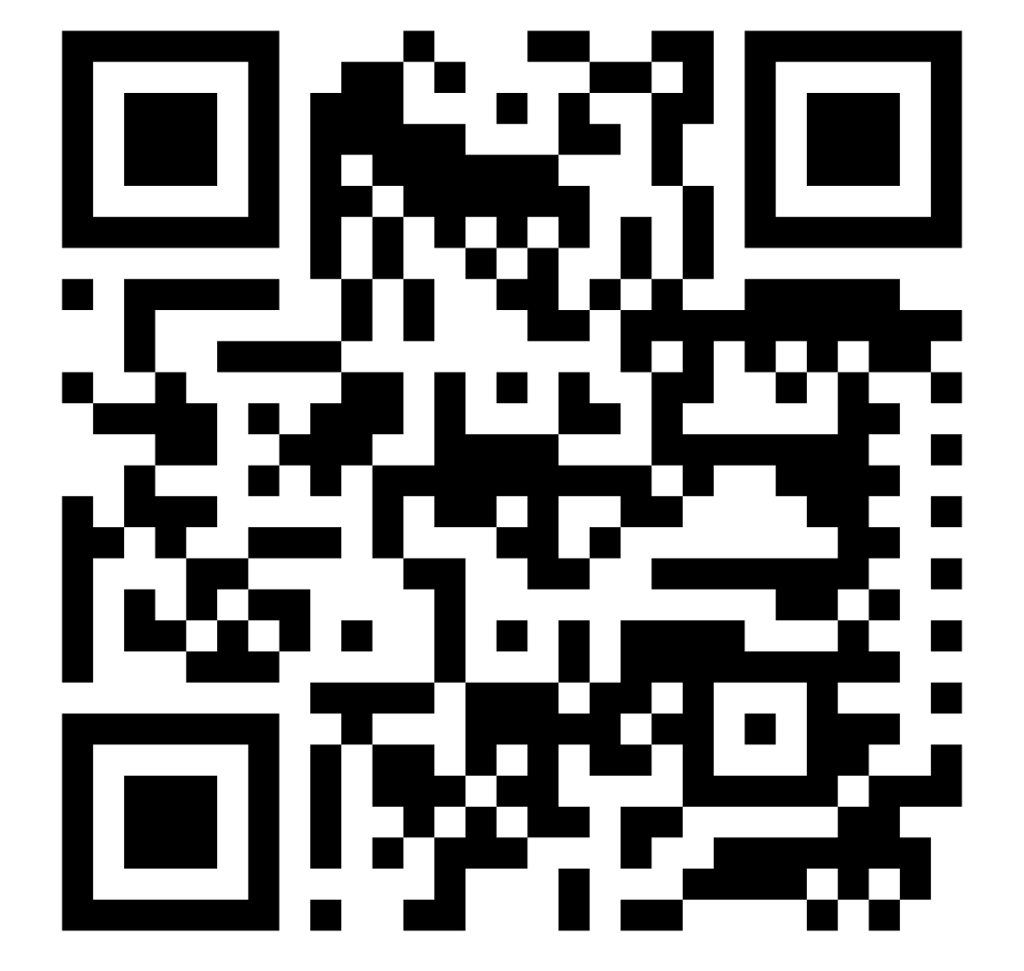
Offer
Social Media Audits
Consulting
Content Creation
Interested? www.wvsocialmedia.com/start
Scan the QR Code and Fill Out the Form:

Slide 25


