Slide 1


Slide 2
Thank You to Our Generous Company Sponsors.

Slide 3

Platinum Sponsor

Slide 4

PlatSponsor

Slide 5




Platinum Sponsor

Slide 6

Gold Sponsor

Slide 7

Silver Sponsor

Slide 8

Silver Sponsor

Slide 9

Silver Sponsor
Silver Sponsor

Slide 10

Silver Sponsor

Slide 11

Silver Sponsor

Slide 12

Bronze Sponsor

Slide 13

Bronze Sponsor

Slide 14

Bronze Sponsor

Slide 15










General Sponsors

Slide 16



Thank You Exhibitors

Slide 17




Thank You Exhibitors

Slide 18

MEMBERSHIP MEETING
AGENDA
ANTI-TRUST STATEMENT
STATE OF THE ASSOCIATION REPORT
NEW BUSINESS

Slide 19

ANTI-TRUST STATEMENT Presiding over Meeting: Suzette Raines Ashley, President
WE THE UNDERSIGNED UNDERSTAND THAT...The purpose of the meeting of the Board of Directors of the Independent Insurance Agents of West Virginia, Inc., is to conduct business pertinent to the activities of the Association as outlined in the organization’s bylaws. In order to avoid antitrust problems under federal or state laws, members are advised to abide by the following guidelines in any oral discussions or written correspondence with other members or with any other person during any business meetings, continuing education courses or social gatherings, before or after any business meetings:
No exchange of information concerning current or future rates, discounts, surcharges, rate structures or classifications, losses, expenses or other costs, profits, current or future product design or coverage, any current or future terms of sale or other marketing practices; current or future underwriting practices or eligibility for insurance, or any other aspects of the operations of any individual company;
No discussions or correspondence concerning prices or labor rates charged by, or doing business with certain suppliers or service providers for the insurance industry.
No discussions or correspondence concerning any forms of joint or cooperative action which may have an adverse effect on any person or organization.
All participants in any discussion or correspondence are obliged to speak up immediately for the purpose of preventing any discussion falling outside the bounds indicated by these guidelines. Participants are also further advised to raise questions they may have about these guidelines prior to engaging in any questionable discussions.

Slide 20

Leadership
President – Suzette Raines Ashley, Ashley Insurance Agency, LLC
Vice President – Chris Parker, Ferrell & Hill Insurance
Treasurer – Tony Deal, Insurance Centers
Immediate Past President –Chad Nuzum, Hood Insurance Group
National Director – Terri Dodrill, McGriff Insurance Services
Young Agents Chairmen - Brady Campbell, Mountain State Insurance

Slide 21

Board of Directors
Category A – Mike Cvechko, Cvechko Insurance Services
Category B – Michael Winter, Bray & Oakley Insurance Agency
Category C – Beth Bailey, Bill Bailey Insurance Agency
Category D – Nick Dyer, Blue Ridge Risk Partners
Category E – Charlie Robinson, Assured Partners of WV

Slide 22
Staff
Traci Nelson
Chief Executive Officer
Lora Ball
Programs Coordinator
Daniel Hall
Government Affairs
Access Strategies

Slide 23
Objective
Be a Trade Association that independent insurance agencies of all stripes want to be a member of.

Slide 24
Strong Membership
64 Agency Members
20 Associate Partners

Slide 25
New Members in 2025
Agency of Choice
Countryside Insurance Agency LLC
Mountain State Insurance Group LLC
Comparion Insurance Agency
E&B Insurance
Biggs Insurance

Slide 26
Communications & Training
Nine editions of The Insuror
Numerous bulletins and updates
ABEN on-demand courses
CE Credits earned for belonging to the Big I and for attending Big I Events

Slide 27
Big I Events
Big I Day at the Capitol
Young Insurance Professionals Winter Retreat
Big I Legislative Conference
Women’s Retreat
Young Insurance Professionals Summer Retreat
Annual Convention

Slide 28
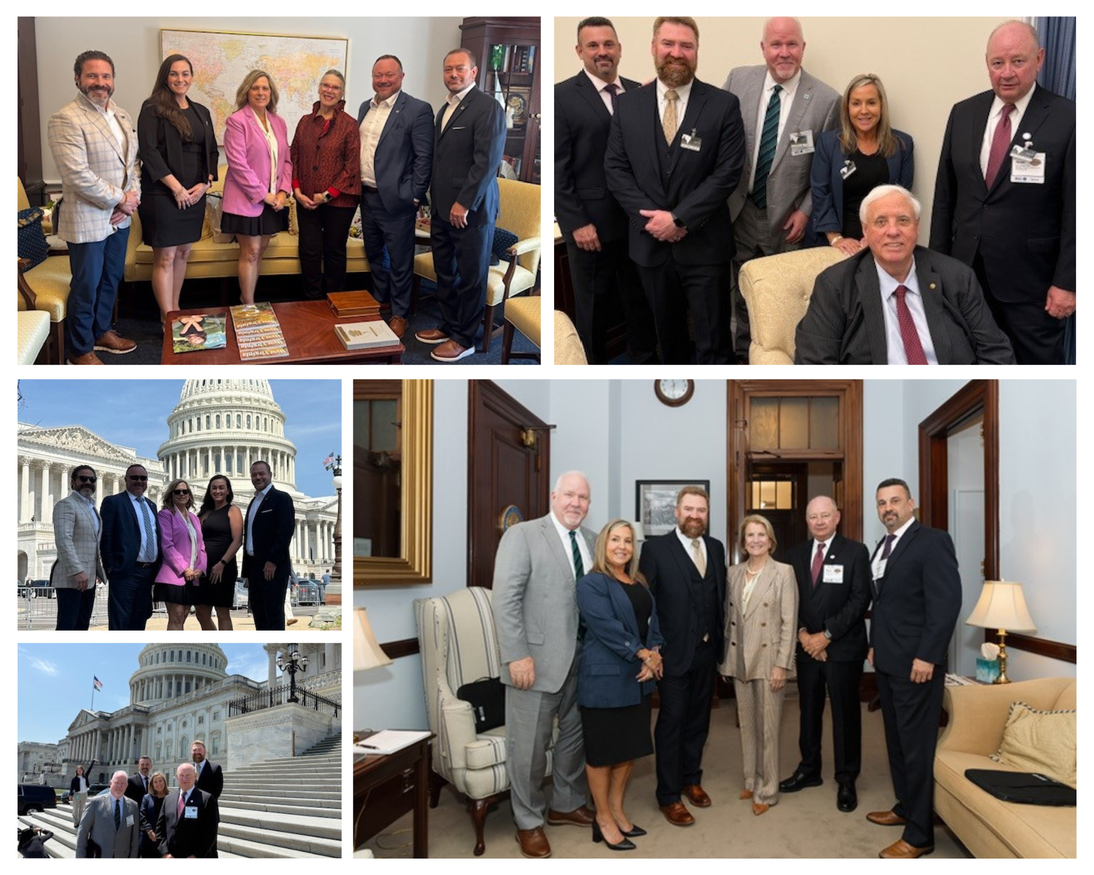
Highlights of 2025
Big I Day

Slide 29
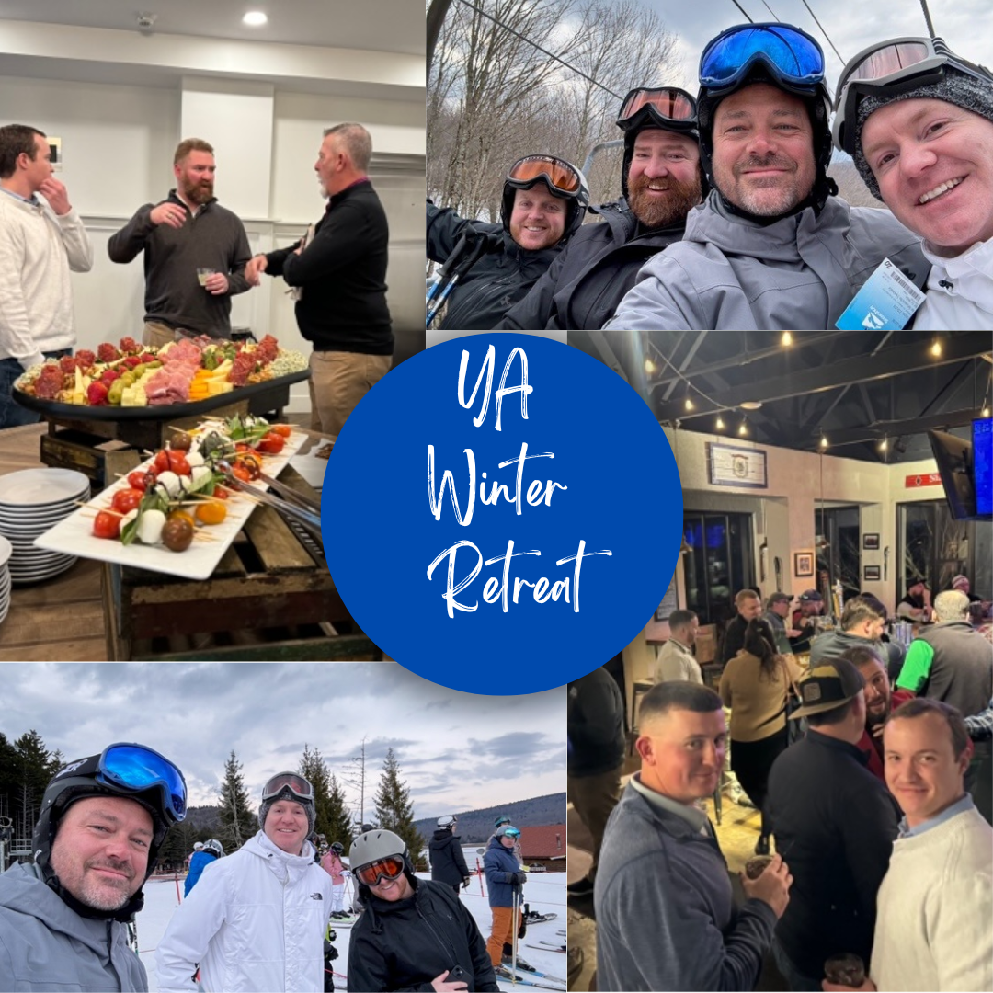
Highlights of 2024
Young Insurance Professionals Winter Retreat

Slide 30
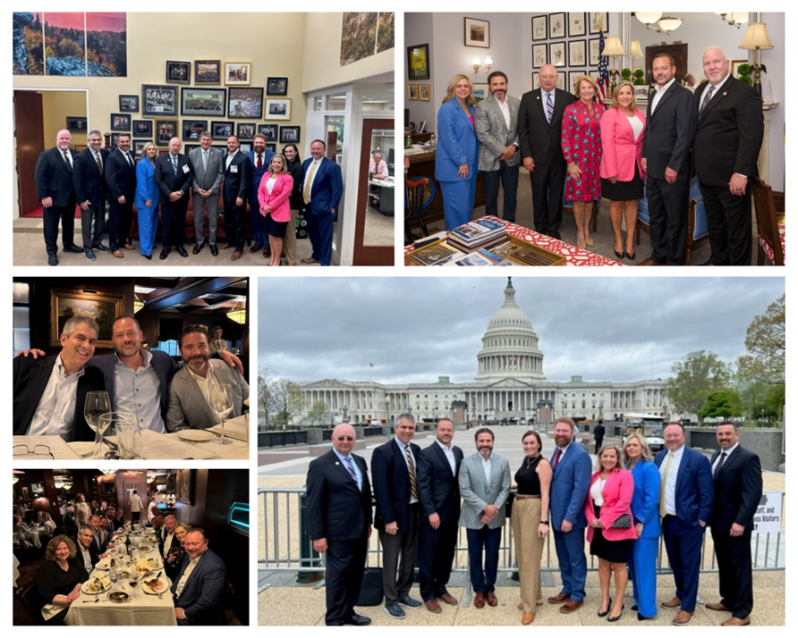
Highlights of 2024
Big I Legislative Conference
Day on the Hill

Slide 31
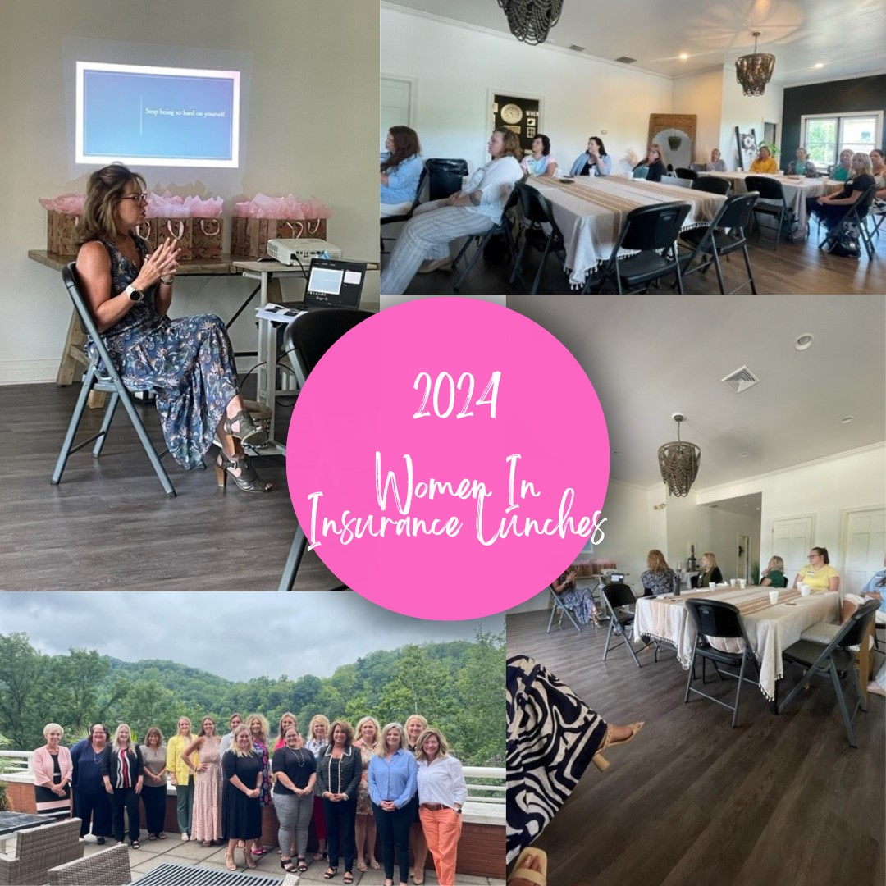
Highlights of 2024
Women in Insurance Lunches

Slide 32
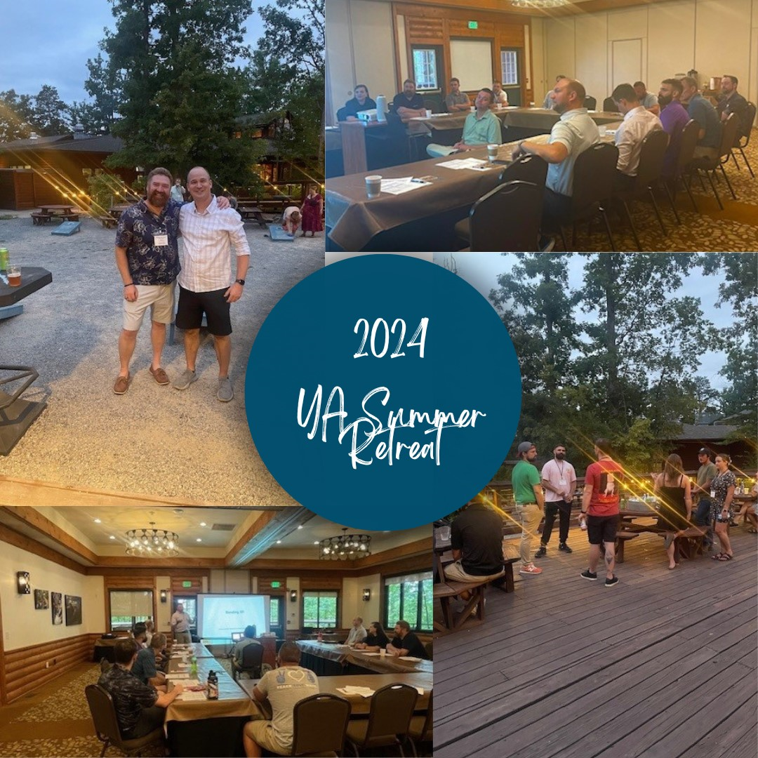
Highlights of 2024
Young Insurance Professionals Summer Retreat

Slide 33
UPCOMING EVENTS

Slide 34

Southern Agents Conference December 5-7, 2025 Atlanta, GA

Slide 35

Insurance Day at the Capitol January 19 & 20, 2026 Charleston - Culture Center

Slide 36

Big I Legislative Conference April 22 – 24 2026 Washington, DC

