Slide 1

Beyond the Policy: Building a Cyber-Resilient Insurance
Agency
KDE Technology
The Reality of Cybersecurity Assessments for the Insurance Industry
By Lee Ayers & Tony Brwon
Notes:
My name is Tony Brown and this is Lee Ayers and we are the managing partners of KDE Technololgy
-headquartered in Charleston, WV with offices in Hurricane, Huntington, and Columbus
We are a digital design, development, and security firm and a large portion of what we do is help small businesses stay protected from cyber threats. We support multiple clients in the insurance industry with a variety of products and services.

Slide 2
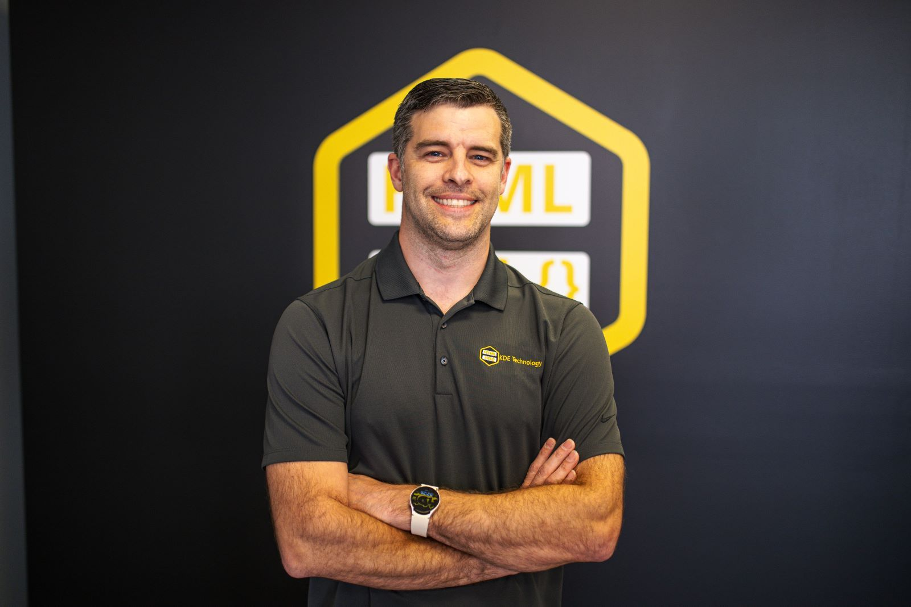
Tony Brown
In a world of technology, my passion is people. I am the bridge between what YOU want and what our designers create. My primary job is taking care of the customer. I am always available to help.
My educational background is in Human Resources and Business Management but what I have learned as a business owner has been priceless. Our team boasts a half century's worth of experience; most of which I get to claim the credit for! Many of the strategies my team and I employ are the very ones that have helped us achieve such early success in our own company. Allow me to show you why KDE Technology is the right fit for you.
Notes:
My skills and experience are primarily in client relations and operations – I’m the bridge between our security team and our clients.
One of my primary jobs is to make sure clients understand what they need and what we are going to do to meet that need
Think of me as your technical translator!

Slide 3
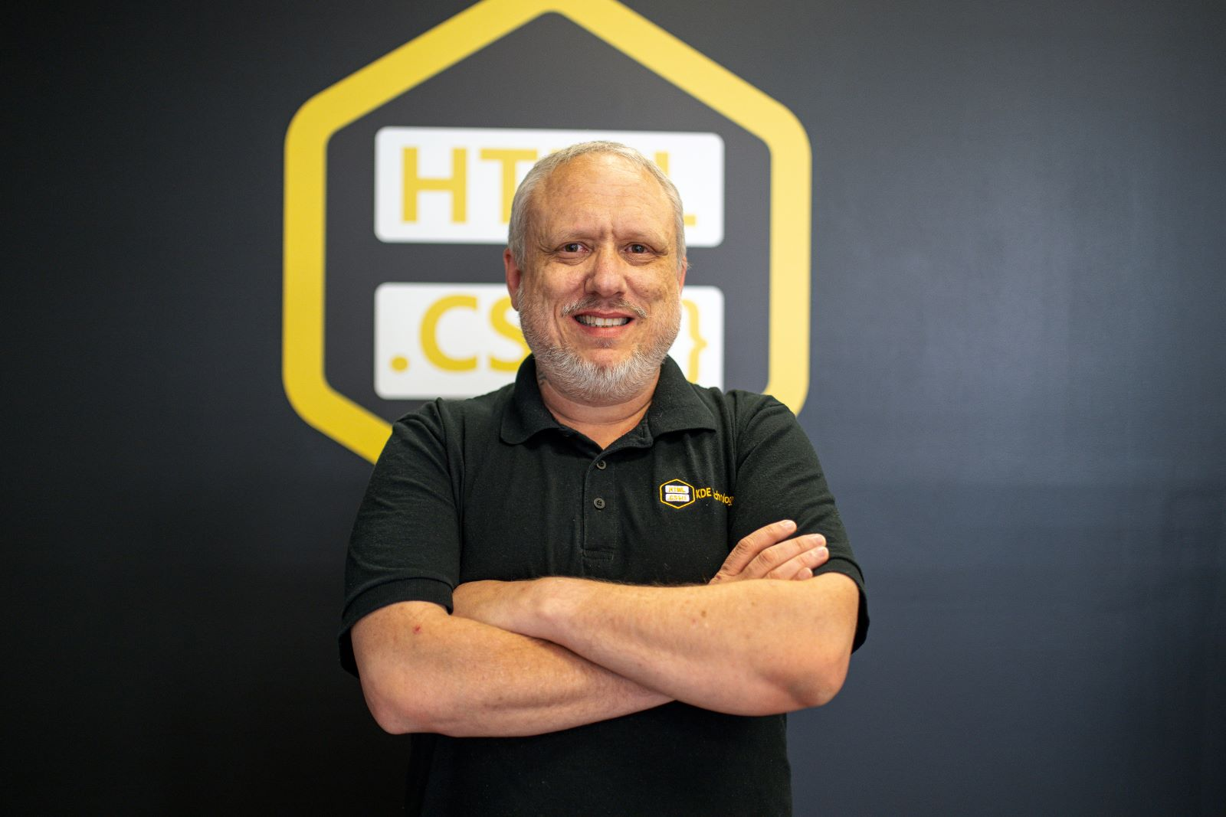
Lee Ayers
Lee is our lead designer. He's a master of custom front-end web development and brings a dozen years of Photoshop experience to the team. Lee is A+, Net+ and Security+ certified. He's also a Master Project Manager, Dell Diagnostic Engineer and Certified Ethical Hacker with a BS in Computer Science from WVU. He also received Tech Crunch Magazines Engineer of the year for his work on Bluetooth technology now used in hospitals across the nation. Lee basically manages the entire technical side of KDE Technology. From working with the back-end guy to the systems admin and the database expert, he manages the lion's share of computer related tasks.
Notes:
Lee is a certified ethical hacker and cyber security specialist with decades of practical knowledge.
He’s also our lead developer, a lock pick, and published author of his very own cyber security novel!
He is truly the genius behind KDE Technology.

Slide 4
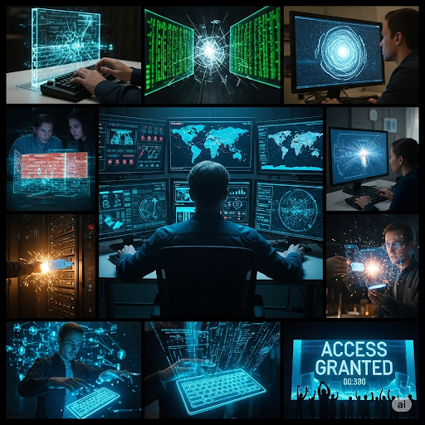
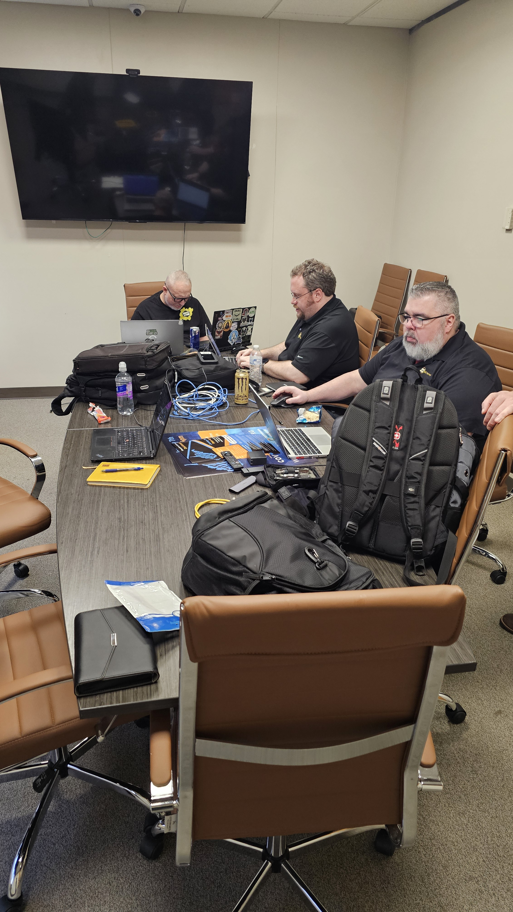
The Myth vs. Reality
  Hollywood's take on hacking: a lone genius, high-stakes espionage, and impossibly complex code.
  The reality: meticulous planning, exploiting simple human error, and leveraging common vulnerabilities.
  Cybersecurity isn't about breaking unbreakable systems; it's about finding the weak links that most organizations overlook.
Notes:
Myth – hooded hackers, 6 monitors, and two people using a keyboard at the same time!
Reality – A bunch of tech nerds surrounded by backpacks hammering away at their laptops.
Cyber security is far less about some highly organized attack and much more about a crime of opportunity – most hackers are simply looking for weak links, not fort knox.
*Give example of vehicles on street

Slide 5
Red Teaming vs. Cybersecurity Assessments
  Cybersecurity Assessments: A comprehensive check-up. Focused on identifying common vulnerabilities and ensuring compliance with industry standards.
  Red Teaming: A realistic attack simulation. Focused on testing your organization's ability to withstand a targeted cyber-attack and protect critical assets like customer data.
  For the insurance industry, assessments often address compliance mandates, while red teaming reveals an attacker's potential path to sensitive customer information and PII (Personally Identifiable Information).
Notes:
Cybersecurity assessments and penetration are often confused
-Most companies need an assessment to determine if and how a pen test should be conducted
Assessments – This is similar to an assumed breach in that you are aware we are on premise and you have provided us access to your physical location and internal network.
-The goal is to determine the obvious weaknesses that exist and provide a plan to remediate those.
Red teaming or penetration testing is when we show up after hours or during the work day, without the prior knowledge of staff, in order to test or ability to breach physical systems like door locks, social engineer our way through staff, and gain access to your most critical systems through a variety of means.
-The goal here is to determine if the systems you have in place to protect you are actually

Slide 6
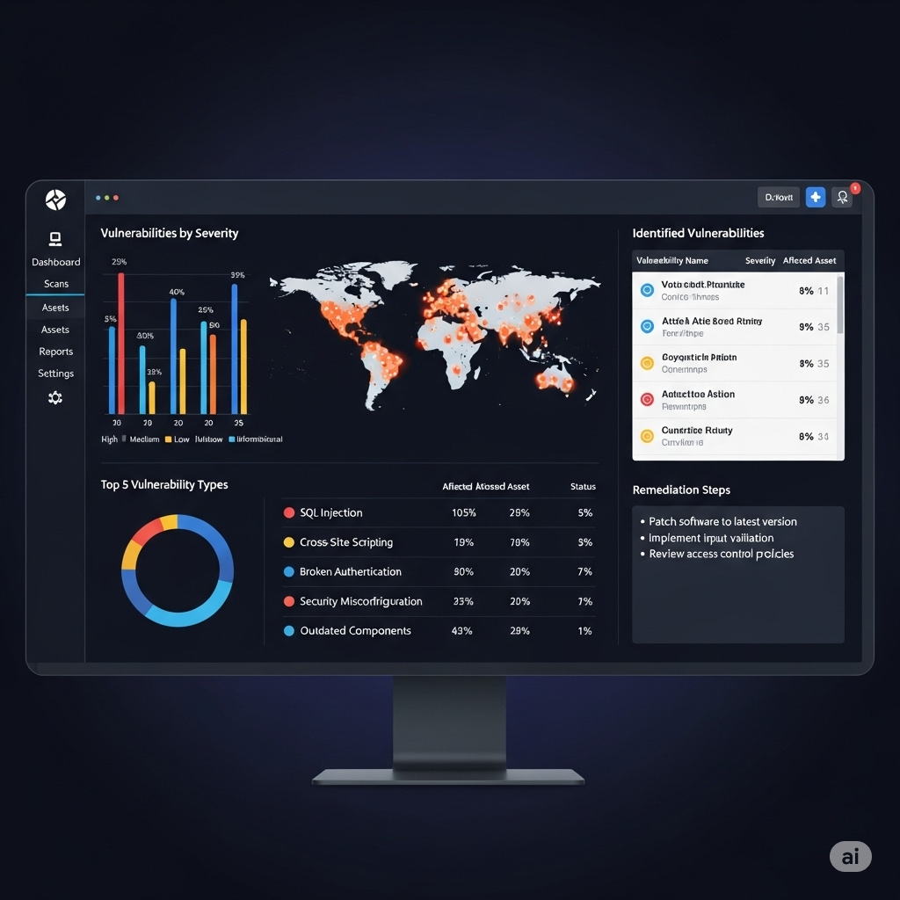
Cybersecurity Assessments: A Proactive Health Check
  Goal: To systematically find and fix common vulnerabilities that could be exploited by a wide range of attackers.
  Involves: Vulnerability scanning, penetration testing (limited scope), and policy reviews to ensure compliance.
  Focus: Building a strong security foundation to protect against the most common types of attacks that your company faces every day.
Notes:
*Give examples of what we do during an assessment
-Complete walkthrough of physical systems
-Review potential vulnerable devices such as printers
-Staff interviews
-Network scanning

Slide 7
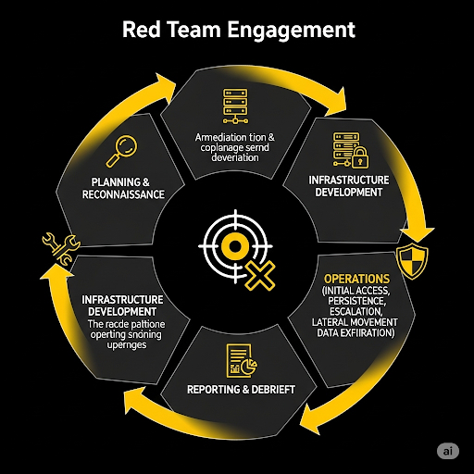
Red Teaming: Simulating the Adversary
  Goal: To test the resilience of your defenses against a dedicated attacker.
  Methods: Social engineering to gain employee trust, physical access testing to breach data centers, and technical exploits to compromise networks.
  Focus: Demonstrating how an attacker could move from an initial point of entry to a devastating data breach."
Notes:
*Give examples of what we do during a penetration test
-Breach cameras and alarms
-Social engineer our way past janitors or after-hours staff
-Install key loggers or other nefarious devices

Slide 8
The Foundation: Everyday Cyber Hygiene
  Strong, Unique Passwords: Use a different, complex password for every account. Consider using a password manager to securely store and generate them. Reusing passwords is a major risk.
  Multi-Factor Authentication (MFA): This is a critical extra layer of defense. It requires a second form of verification (like a code from your phone or app) in addition to your password.
  Phishing & Social Engineering: Never click on links or open attachments from unfamiliar or suspicious senders. Always be skeptical of urgent requests for information or money, especially when sent via email.
  Software Updates: Regularly update your operating systems, applications, and security software to patch vulnerabilities that hackers can exploit.
Notes:
Strong and Unique passwords
Multi-factor authentication
Phishing and Social Engineering
Software Updates
Email is not safe - never send sensitive info or documents via email unless you have set up end to end encrypted emails.
Never share credentials – no one should ever know your password or be logged into an account that belongs to you. Treat passwords like a social security number.

Slide 9
Beyond the Basics: The Insurance Industry as a Prime Target
  Wealth of Sensitive Data: We handle a treasure trove of Personally Identifiable Information (PII) including Social Security numbers, health records, financial data, and claims histories.
  High-Value Transactions: Our industry involves large financial transactions, making us an attractive target for financial fraud and cyber extortion.
  Complex Network of Third-Parties: We are interconnected with a vast web of agents, brokers, and third-party vendors. A breach at any one of these partners can create a vulnerability for us all.
  Regulatory Compliance: Our industry operates under strict regulations like the NAIC's Model Law and GLBA, which mandate robust security practices and require us to protect customer data.
Notes:
SO. MUCH. PROTECTED INFORMATION.
-Social security numbers, health records, etc are obvious
-Financial records or even a full name, address and email together are considered PII
Large financial transaction occur between multiple parties
It takes a network of third parties working together for you to do your job. Data is most at risk while in transit and you are sending sensitive data back and forth between different entities on a daily basis.
The insurance industry has strict regulations such as NAIC Law, GLBA compliance, and HIPPA just to name a few. This industry has to be even more diligent than many others to stay in compliance and out of hot water.

Slide 10
Common Threats to the Insurance Sector
  Ransomware: Attackers encrypt your files and demand payment to restore access. This can halt all business operations and result in significant financial losses.
  Business Email Compromise (BEC): Criminals impersonate executives or clients to trick employees into making fraudulent wire transfers or revealing sensitive information.
  Third-Party and Supply Chain Attacks: Attackers exploit a weakness in a vendor’s software or a partner’s system to gain unauthorized access to our network.
  Insider Threats: Both malicious employees who intentionally steal data and negligent employees who accidentally cause a breach pose a significant risk.
Notes:
Ransomware is a common and devastating attack within the insurance industry. Imagine as a broker being locked out of your entire system – files, email, software access, everything. And then being told you can only regain access if you make a bitcoin payment of $100,000. This is an unfortunate reality for many agencies around the world that are not properly protected.
Business Email Compromise is one of the most effective attacks because the hacker sends communication from within breached email accounts or from spoofed accounts that look internal. Either way, the recipient is easily fooled because the email seems like a legitimate internal email. This is a case where it only seems like “the call is coming from inside the house!”
Often, attackers breach smaller, third-party companies that do business with or communicate with larger companies so that they can more easily gain access to the system they really want to breach. This is why it’s also very important to ensure those you do business with are also taking security seriously and implementing measures to prevent breaches.
A potential but less likely concern is disgruntled employees who my carelessly or intentionally cause problems internally. Much more common, is an employee who accidentally does something negligible like clicking a malicious link or leaving a computer unlocked while going to the bathroom, making it easier for bad actors to do what they do.

Slide 11
Case Study: The Aflac Data Breach
What Happened: In June 2025, Aflac disclosed a data breach resulting from "social engineering tactics" used by a sophisticated cybercrime group.
Impact: The unauthorized access potentially exposed a wide range of sensitive data, including Social Security numbers, health records, and claims information for a large number of individuals.
Aflac's Response: Aflac swiftly contained the intrusion, notified affected individuals, and offered free credit monitoring and identity theft protection. The breach also led to several class-action lawsuits.
The Takeaway: This incident proves that social engineering remains a primary attack vector, and the consequences of a breach extend beyond the initial cost to include significant litigation and long-term reputational damage.
The Cause, Social Engineering: Given the suggested link to Scattered Spider and the nature of other attacks in the insurance industry at the time, social engineering is considered the likely attack vector, where an employee may have been tricked into granting access to the network.
Notes:
Talking Points:
Another recent and very telling example is the Aflac data breach, which happened around the same time as the Erie incident.
In this case, the criminals used social engineering—they tricked an employee into giving them access. This shows that the weakest link in our security is often the human element.
The consequences of this attack were not just operational; they were legal and financial. Aflac had to deal with the cost of providing credit monitoring, legal fees, and the damage to their brand reputation.
This case is a stark reminder that even large, well-resourced companies are vulnerable, and that every employee needs to be trained to spot these attacks.

Slide 12
Proactive Defense: Strategies for Your Agency
  Develop a Written Incident Response Plan: This plan should outline clear roles, responsibilities, and steps to take during a breach.
  Containment: The first priority is to isolate affected systems to prevent the attack from spreading and causing further damage.
  Forensic Investigation: Engage with cybersecurity experts to determine the scope of the breach, how it happened, and what data was compromised.
  Communication: Have a pre-defined communication strategy for clients, regulators, and the public to ensure transparency and maintain trust.
  Data Backup and Recovery: Maintain secure, tested, and segregated data backups to enable swift recovery and minimize business interruption.
Notes:
Talking Points:
Even with the best preventative measures, a breach is always a possibility. When it happens, having a plan is the difference between a minor incident and a catastrophic failure.
Your incident response plan should be a living document that everyone knows. It should clearly define who is responsible for what.
When a breach is detected, the immediate goal is to contain it. This could mean shutting down a server or disconnecting a computer from the network to stop the attack in its tracks.
Once contained, you need to call in the experts. Forensic analysis is critical to understanding the full extent of the damage.
Communicate clearly and honestly. Your clients and regulators need to know what happened and what you're doing about it.
And finally, a great backup and recovery plan is your ultimate safety net. It allows you to restore your data and get back to business without having to pay a ransom or lose critical information.

Slide 13
Strong Passwords vs. Passphrases: The Best Practices
  Go Long: Aim for a password or passphrase of at least 16 characters. Length is often more important than complexity.
  Be Random: Avoid using personal information, common words, or keyboard patterns (e.g., "password123," "QWERTY"). Attackers use automated tools to guess these.
  Mix It Up: Use a combination of uppercase and lowercase letters, numbers, and symbols.
  What's a Passphrase? A passphrase is a longer, more memorable password created by stringing together several random, unrelated words (e.g., "correct-horse-battery-staple"). It is much harder to guess than a single-word password.
  Never Reuse: The golden rule: use a unique password for every single account. If one account is compromised, the others will remain secure.
Notes:
Talking Points:
Let’s dive deeper into the first foundational pillar of cybersecurity: creating strong passwords. The landscape has changed, and the old rules aren't enough.
The most important rule today is to go long. A password with 16 characters or more is significantly harder for a computer to crack than a shorter one. This is because every additional character adds an exponential layer of complexity.
Secondly, you must be random. Hackers use programs that can quickly try millions of common words and phrases. Using personal details or predictable patterns is like leaving the key under the doormat.
We still recommend a mix of characters to make passwords harder to guess. But let's talk about the difference between a password and a passphrase.
A passphrase is a great alternative to a complex, hard-to-remember password. It's a string of random words that is both very long and memorable for you. For example, "correct horse battery staple" is a fantastic passphrase—it's easy to remember but incredibly difficult for a computer to guess.
Finally, the single most critical rule is to never reuse passwords. This is where most breaches begin. A hacker may steal your password from a company's data breach and then use automated software to try that same username and password on all your other accounts, like your bank or email. This is called a "credential stuffing" attack.

Slide 14
Streamlining Security: The Power of Password Managers
  The Problem: We have too many accounts to remember a unique, strong password for each one. Writing them down or reusing them creates a major security risk.
  How They Work: Password managers are encrypted vaults that securely store all your unique passwords, passphrases, and other sensitive information. You only need to remember one master password to unlock the vault.
  Key Benefits:
    Generate Strong Passwords: Automatically creates unique, complex passwords for every new account.
    Secure Auto-fill: Safely fills in your login credentials, preventing phishing sites from stealing your information.
    Sync Across Devices: Access your passwords securely from your computer, phone, or tablet.
    Shared Access: Safely share login credentials with colleagues without sending them over unsecure channels like email.
Notes:
Talking Points:
Now, I'm sure many of you are thinking, "How can I possibly remember a different 16-character password for all my work accounts, let alone my personal ones?" This is where technology comes to the rescue.
The reality is, we all have too many accounts to rely on our memory. Trying to do so leads to weak passwords or writing them down on sticky notes, which is a huge security risk.
A password manager is an essential tool for modern cybersecurity. Think of it as a digital, highly encrypted key ring for all your online accounts. You only need to remember one very strong master password to unlock it.
The benefits are significant. Password managers can automatically generate unique, complex passwords for you, so you never have to think about it.
When you go to log into a website, it will auto-fill your credentials securely, which also helps protect you from fake, phishing websites.
And they sync across all your devices, so you have your passwords wherever you are, completely secure.
For an agency, password managers also provide the ability to safely share passwords for company accounts with colleagues, without risking them being sent in an insecure email. This makes it much easier to manage team access and ensure security.
Implementing a password manager for your agency is one of the most effective and straightforward steps you can take to dramatically improve your cybersecurity posture today.

Slide 15
Why Strong Passwords Matter: An Ethical Hacking Demonstration
  What is a Password Hash? A hash is a one-way cryptographic function that turns a password into a unique, fixed-length string of characters. It is not encryption—it cannot be reversed.
  How Cracking Works: A hacker doesn't "un-hash" your password. They use automated tools to generate millions or billions of potential passwords, hash each one, and compare the result to the stolen hash.
  Demonstration: Cracking a Weak Password
    I will use a tool called Hashcat to demonstrate how quickly a weak password hash can be cracked.
    This will visually illustrate the speed and efficiency of modern cracking tools against passwords that are short, simple, or commonly used.
  The Takeaway: This demonstration isn't to show you how to hack. It's to prove that the fundamental principles of password security—length, randomness, and uniqueness—are your most effective defenses against these tools.
Notes:
Talking Points:
Before we move on, I want to give you a quick, live demonstration to visually prove why everything we've talked about—from long passwords to passphrases—is so critical.
First, let's clarify what we're actually doing. When a company stores your password, they don't store it in plain text. They use something called a hash. A hash is like a unique digital fingerprint of your password. It's a one-way function, meaning you can't reverse the process to get the original password back.
So, a hacker doesn't "un-hash" your password. What they do is steal the list of hashes and then use powerful tools to guess passwords at an incredible rate. They take a word from a list, hash it, and see if it matches the stolen hash. If it's a match, they know your password. This is why using common words or short passwords is so dangerous.
For this demonstration, I'll be using a tool called Hashcat, which is a widely used and very powerful password recovery and cracking tool. I'm going to take a password hash from a completely generic and non-malicious source and show you how quickly a common password can be cracked.
(At this point, you would begin your demonstration with a generic password hash.)
As you can see, the tool is able to guess the password almost instantly because it was short and common. This highlights the sheer power and speed of these automated tools.
The key takeaway from this isn't to show you how to do this. It's to reinforce the importance of what we've been discussing: length, randomness, and uniqueness. These are the only things that will slow down a tool like Hashcat and protect your accounts.
A strong, long password or passphrase would have taken this tool days, months, or even years to crack, which is a powerful deterrent for any cybercriminal. This is the difference between being an easy target and being a protected one.

Slide 16
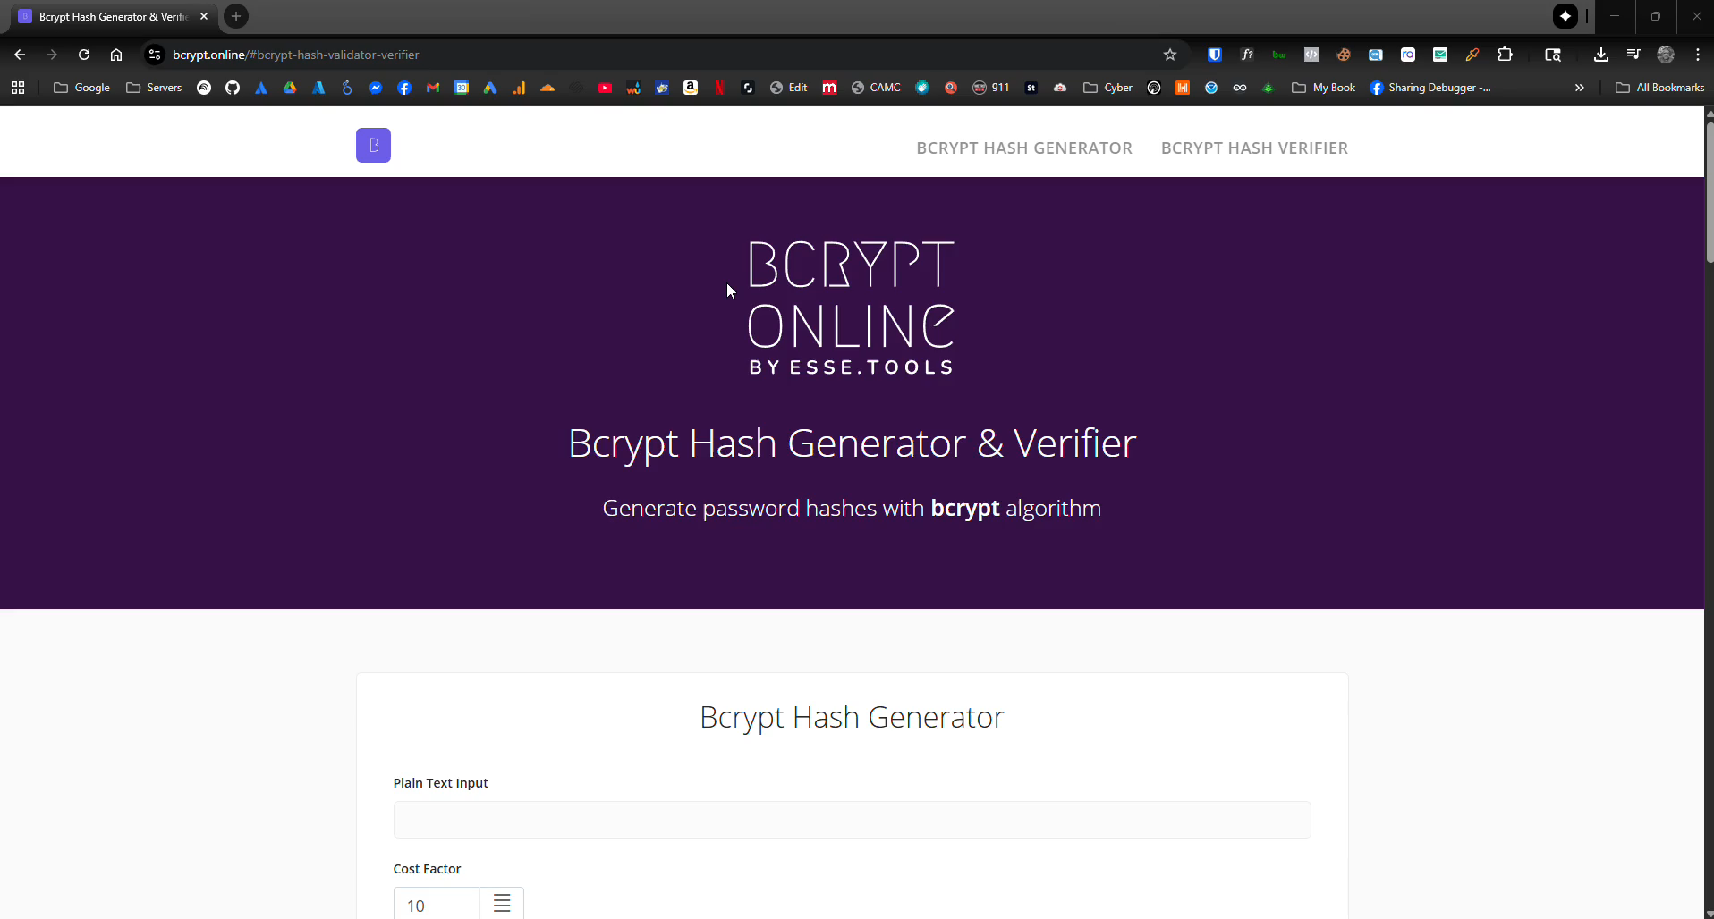

Slide 17
Questions & Discussion
That concludes our presentation. Thank you again for your time and attention. We are now happy to take any questions you may have.
Notes:
Final Thoughts: If you only get one thing from today’s presentation, (my apologies for boring you to death), it should be that you really need to improve your password and communication management and be diligent in these areas. This is an inexpensive, simple step that prevents most cyber attacks. Don’t get caught up in the fancy firewalls and antivirus, YOU are the first and strongest line of defense – I promise you that. Strong passwords and management practices along with secure email communication are the foundation of any cyber security plan.

